Slide 1
Chiba Campaign 2022
Section: Satellite related analyses
Reporter: WU YOU
Date: 2022.12.07

Slide 2
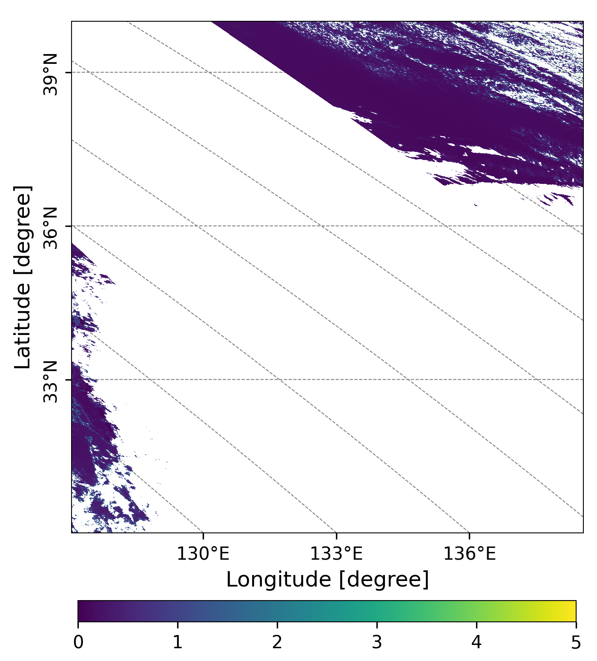
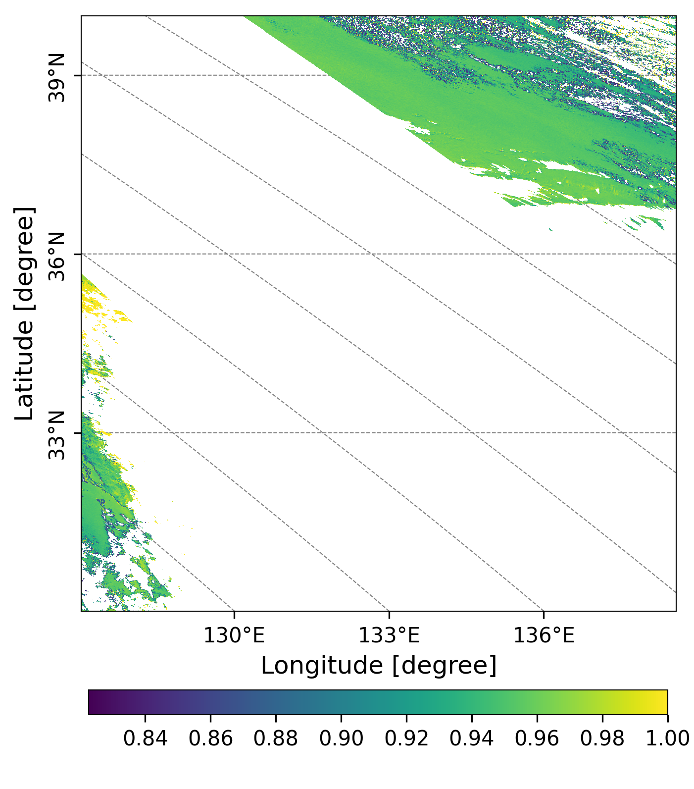
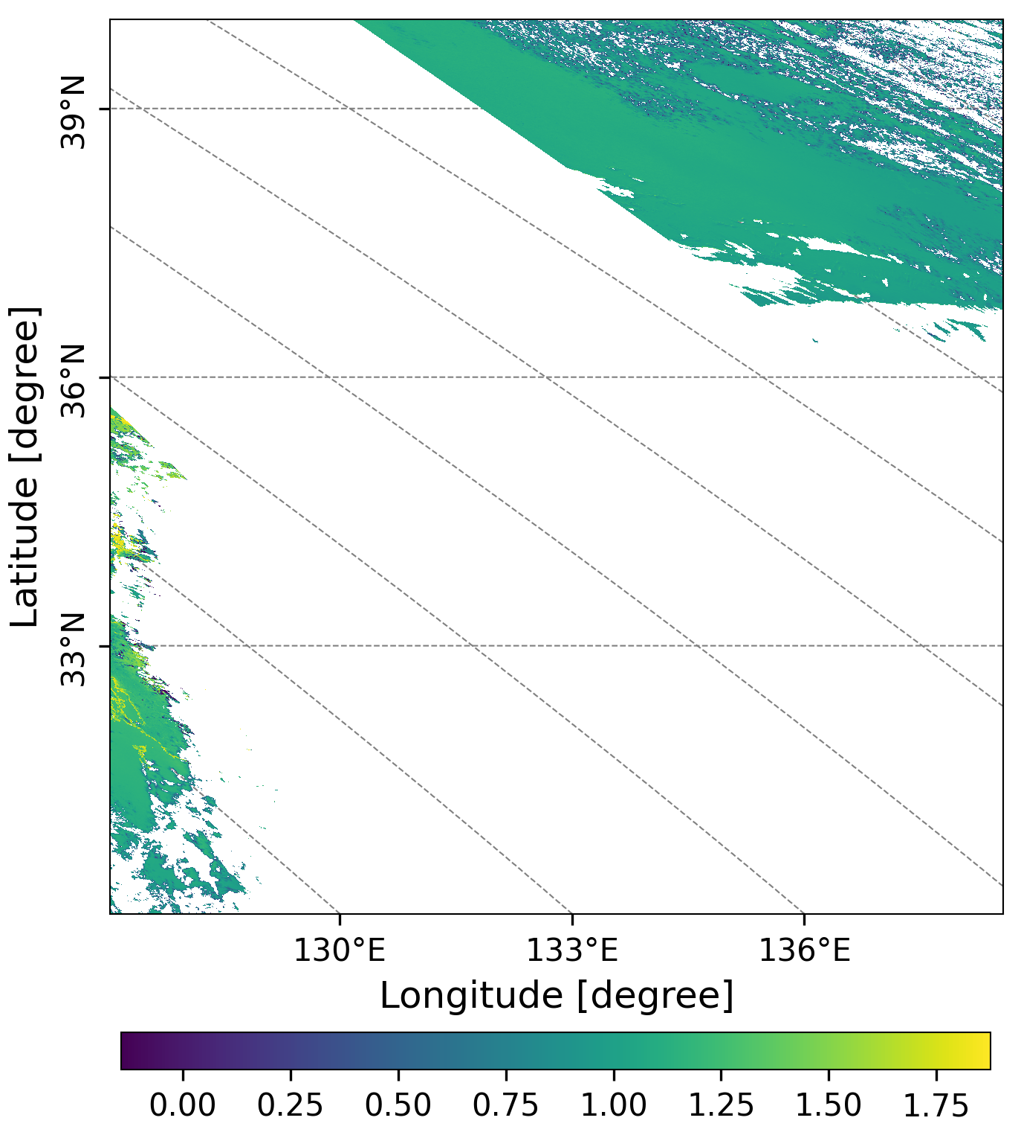
20221128
GC1SG1_20221126D01D_T0529_L2SG_ARNPK_3000.h5
(a)
(b)
(c)
Light-scattering aerosol exits
Figure1. AOD (a) at 500 nm, SSA(b) at 380 nm and AE(c) at 500 and 380 nm over Honshu and Shikoku (本州＋四国)
observed by GCOM-C on Nov.26, Saturday.

Slide 3
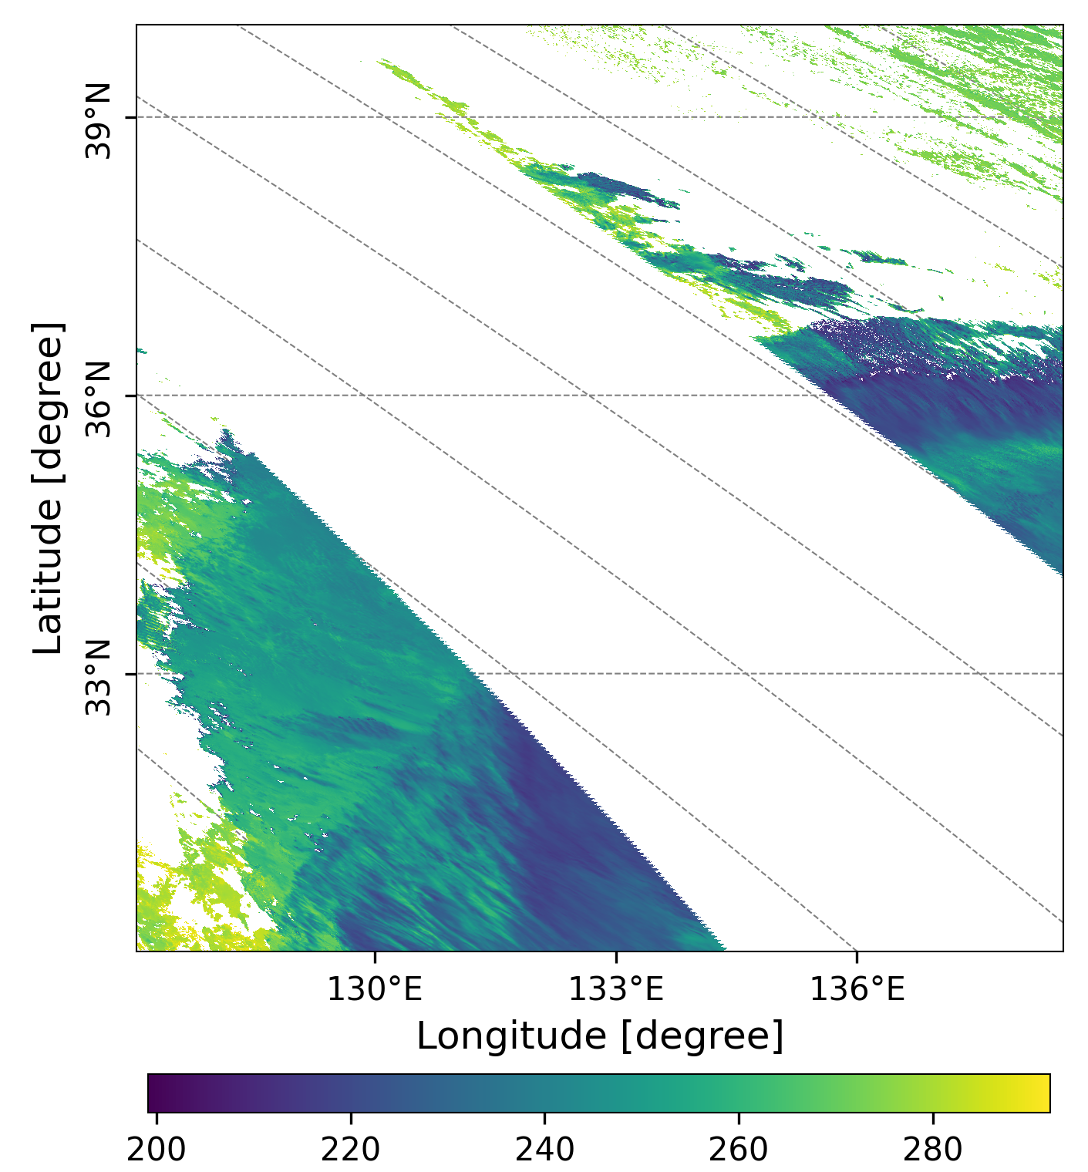
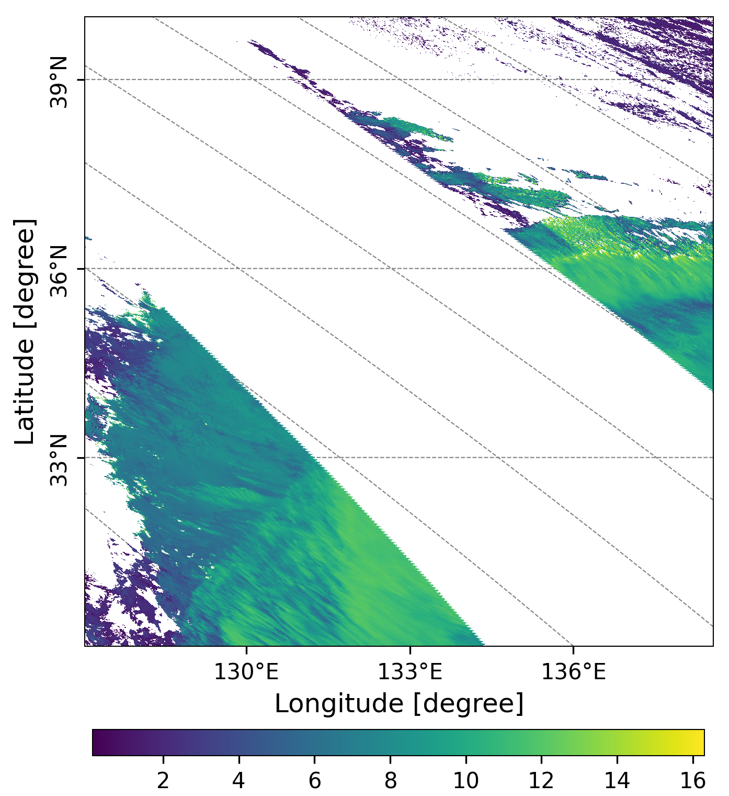
GC1SG1_20221126D01D_T0529_L2SG_CLPRK_3000.h5
(a)
(b)
There was
Figure 2. Cloud Top Temperature (a, Unit: K), and Cloud Top Height (b, Unit: Km) over
Honshu and Shikoku (本州＋四国)observed by GCOM-C.

Slide 4
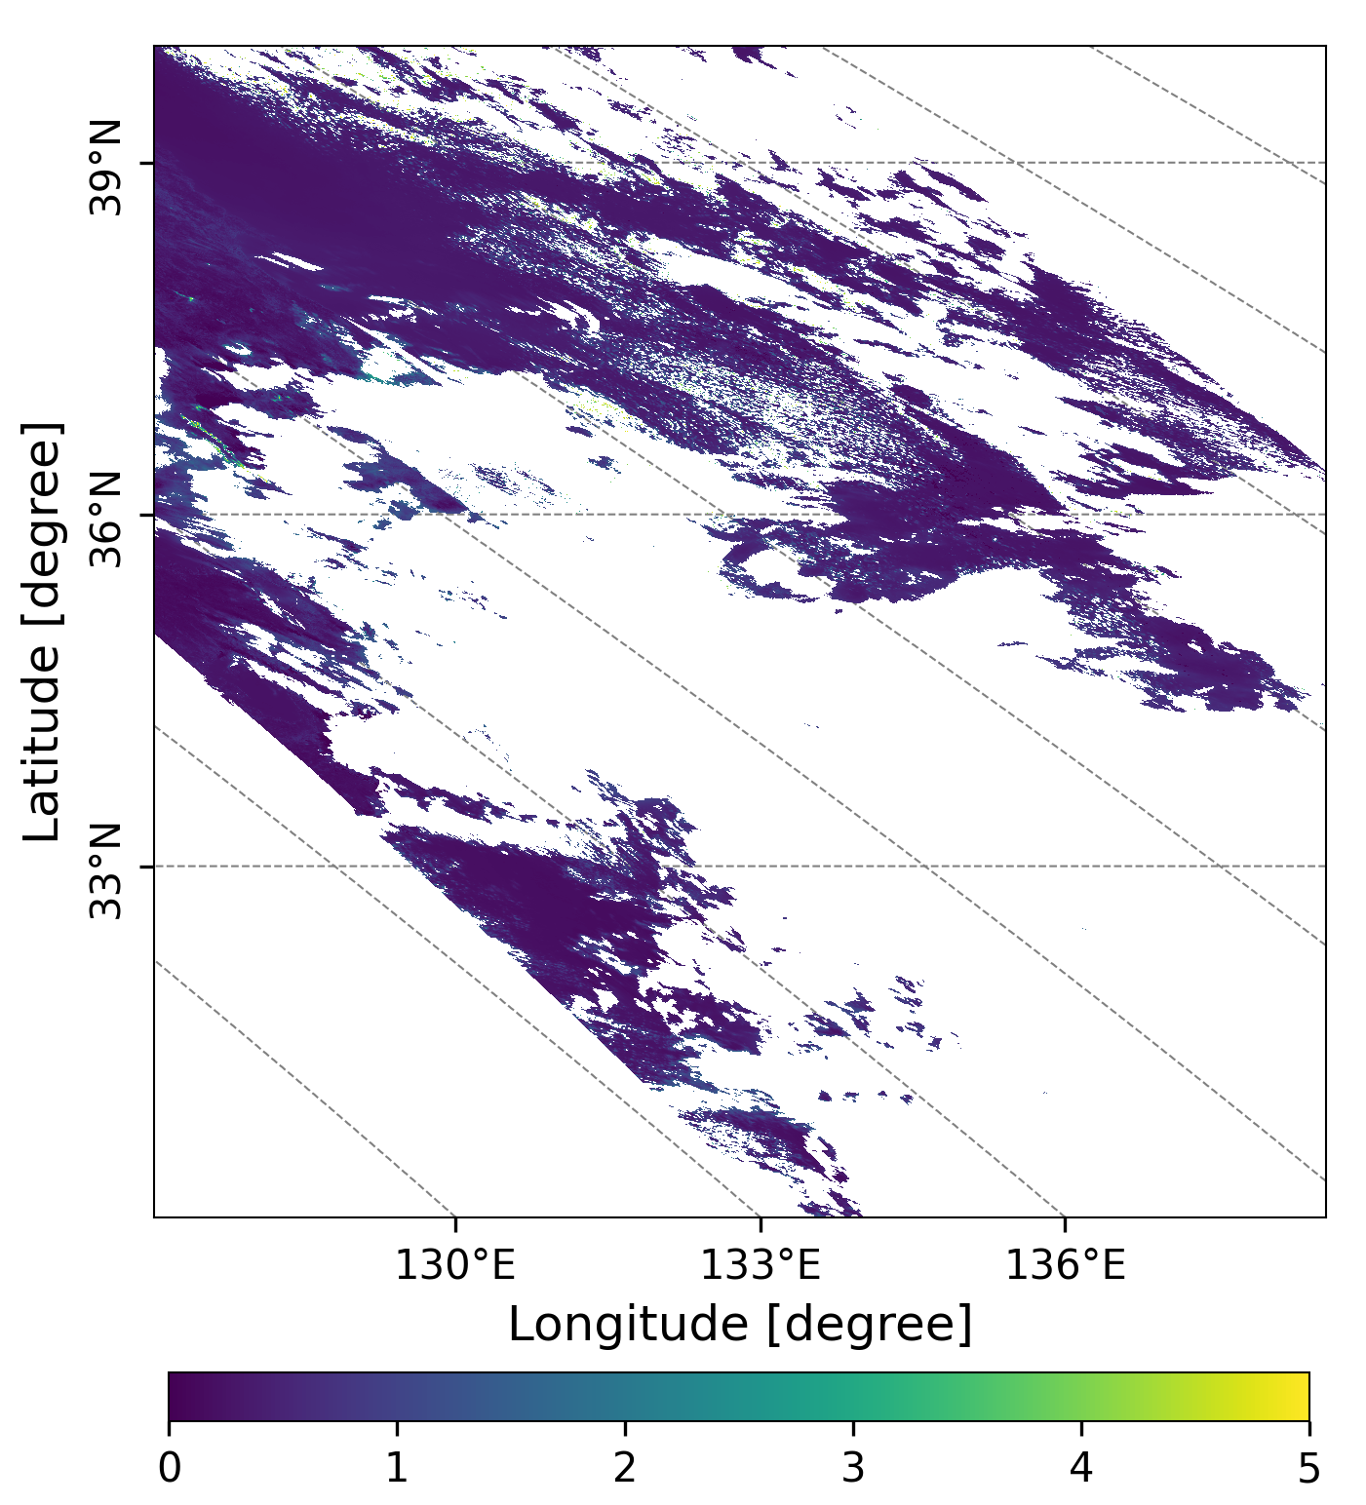
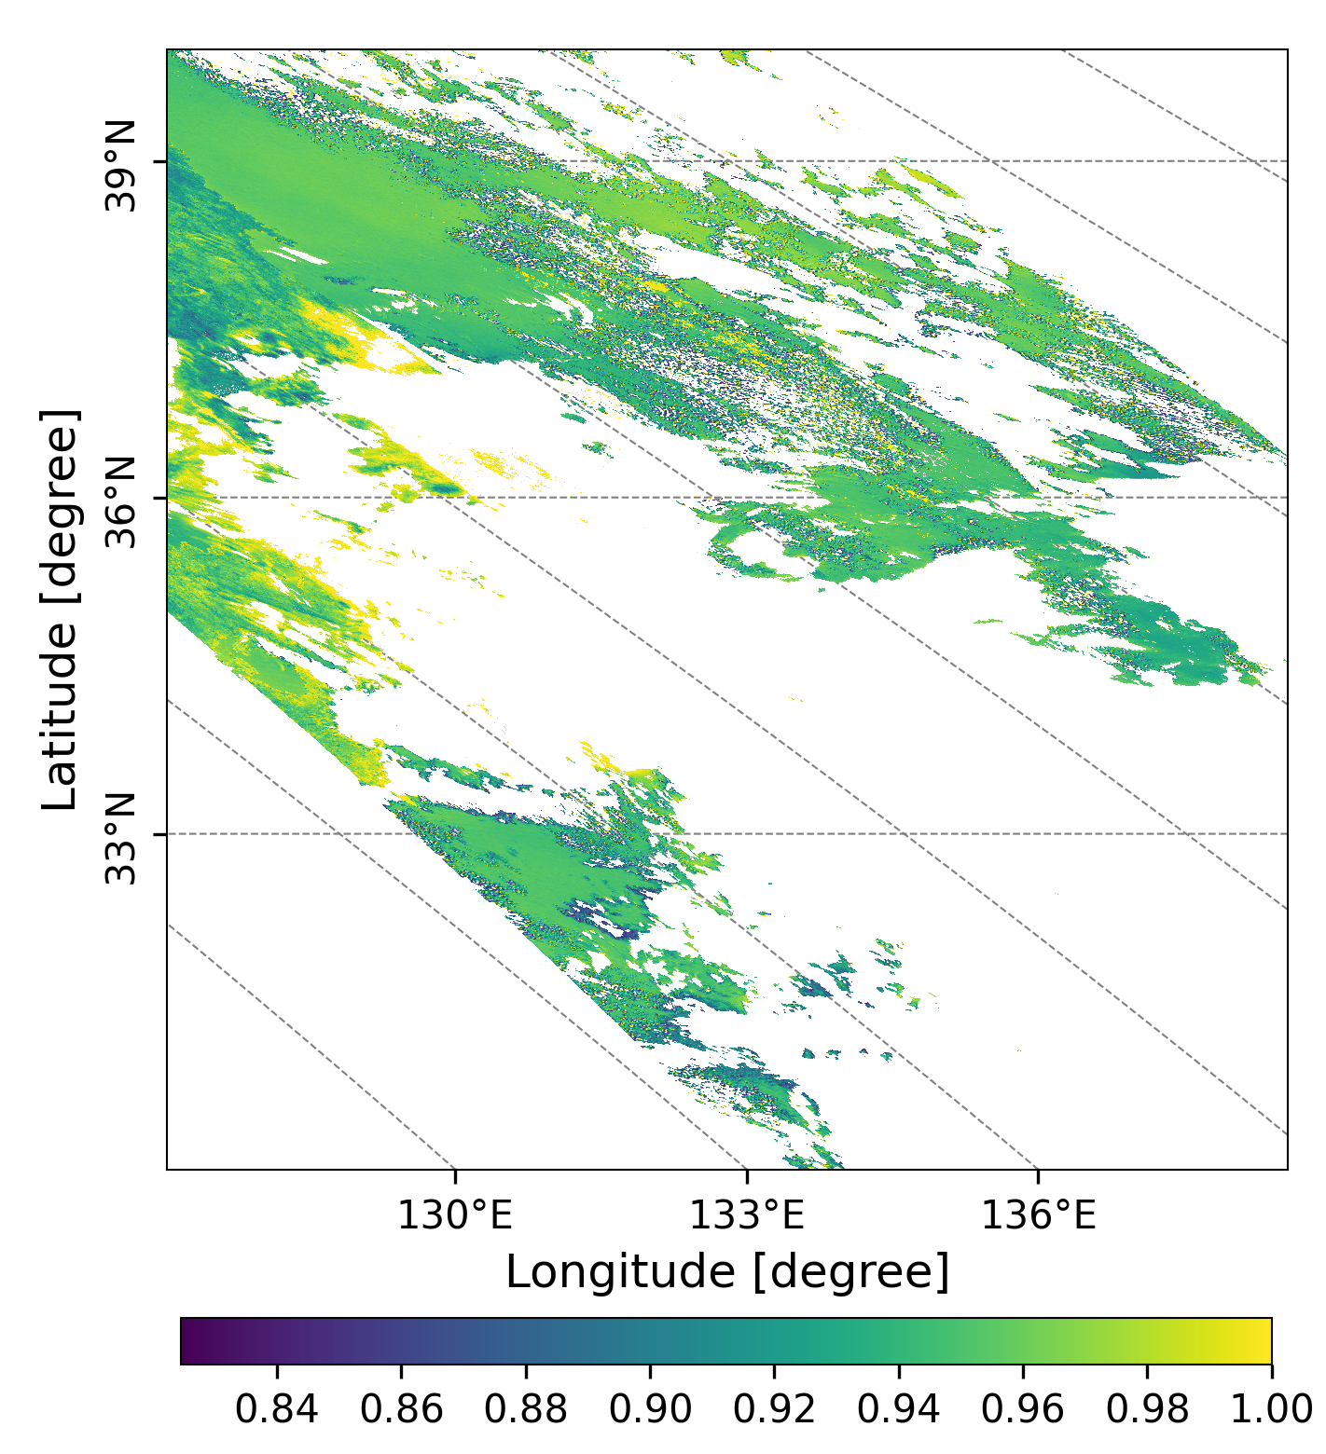
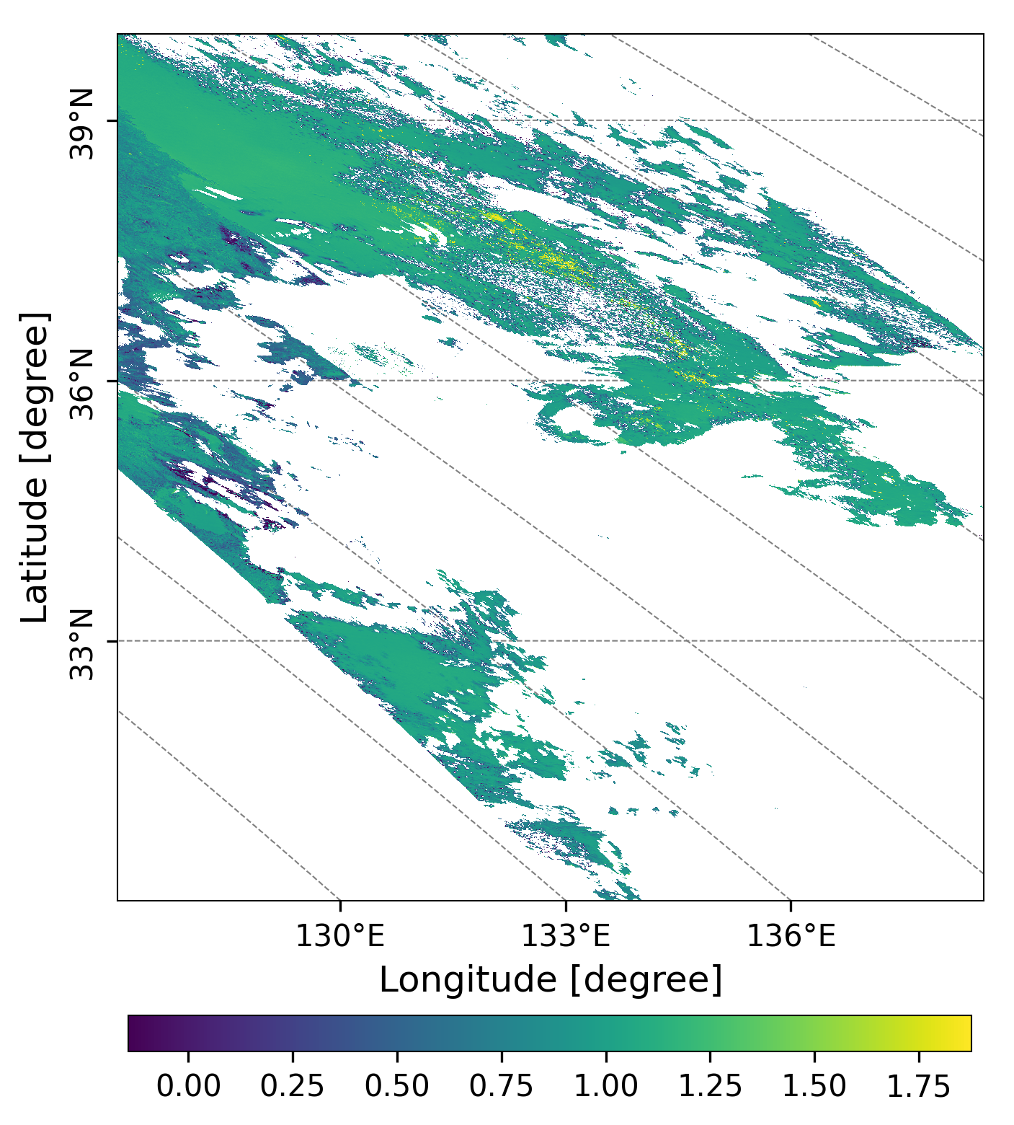
20221129
GC1SG1_20221128D01D_T0529_L2SG_ARNPK_3000.h5
(a)
(b)
(c)
Figure3. AOD (a) at 500 nm, SSA(b) at 380 nm and AE(c) at 500 and 380 nm over Honshu and Shikoku (本州＋四国)observed by GCOM-C on Nov.28, Monday.

Slide 5
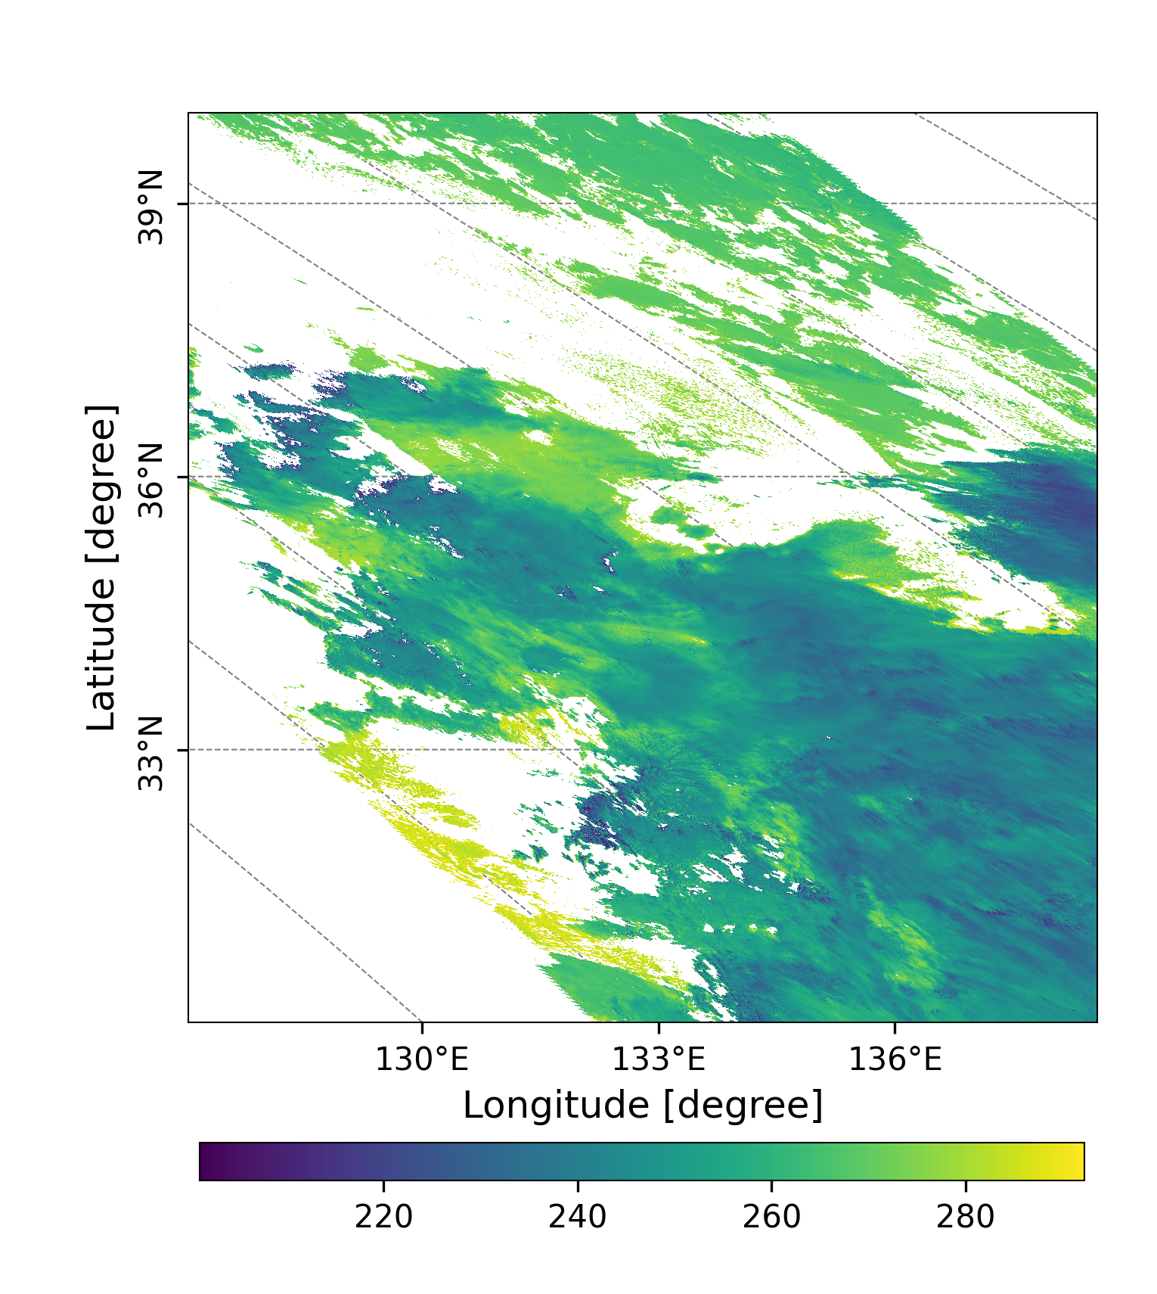
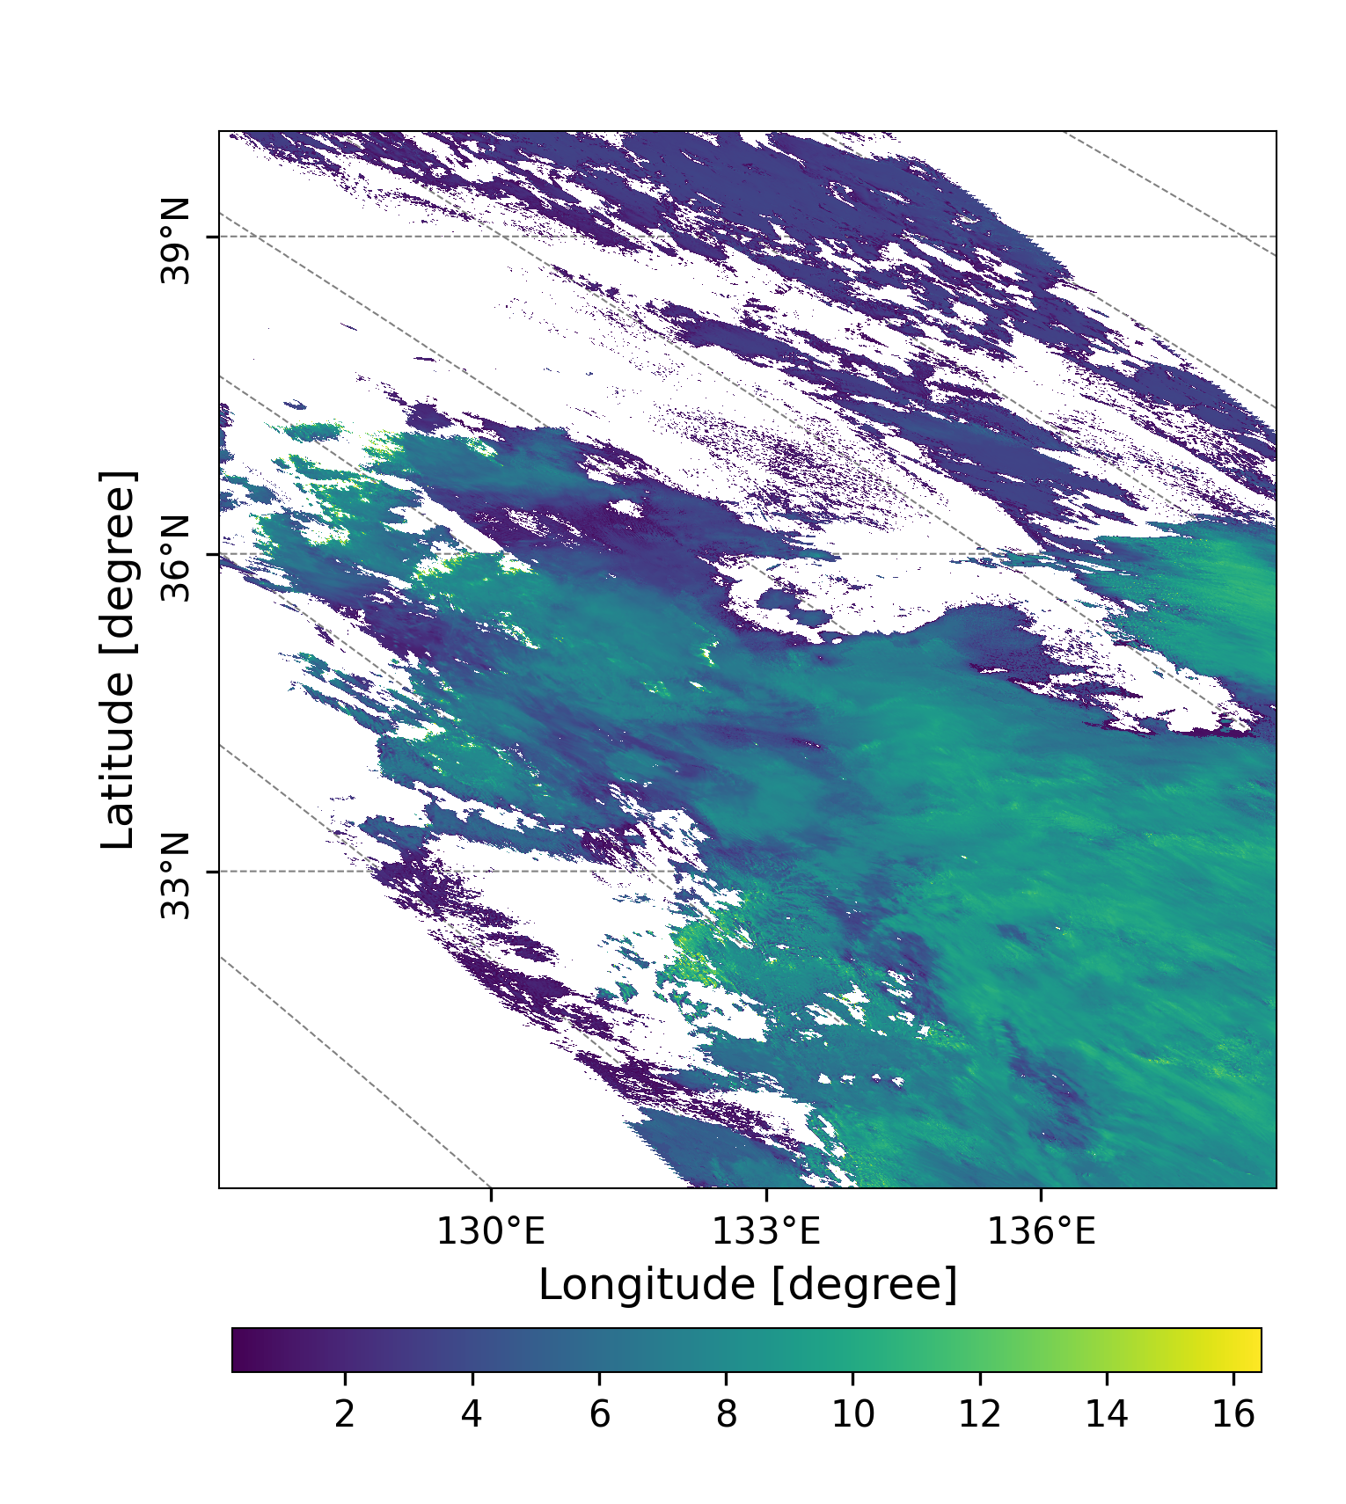
GC1SG1_20221128D01D_T0529_L2SG_CLPRK_3000.h5
(a)
(b)
Figure 4. Cloud Top Temperature (a, Unit: K), and Cloud Top Height (b, Unit: Km) over
Honshu and Shikoku (本州＋四国)observed by GCOM-C on Nov.28, Monday.

Slide 6
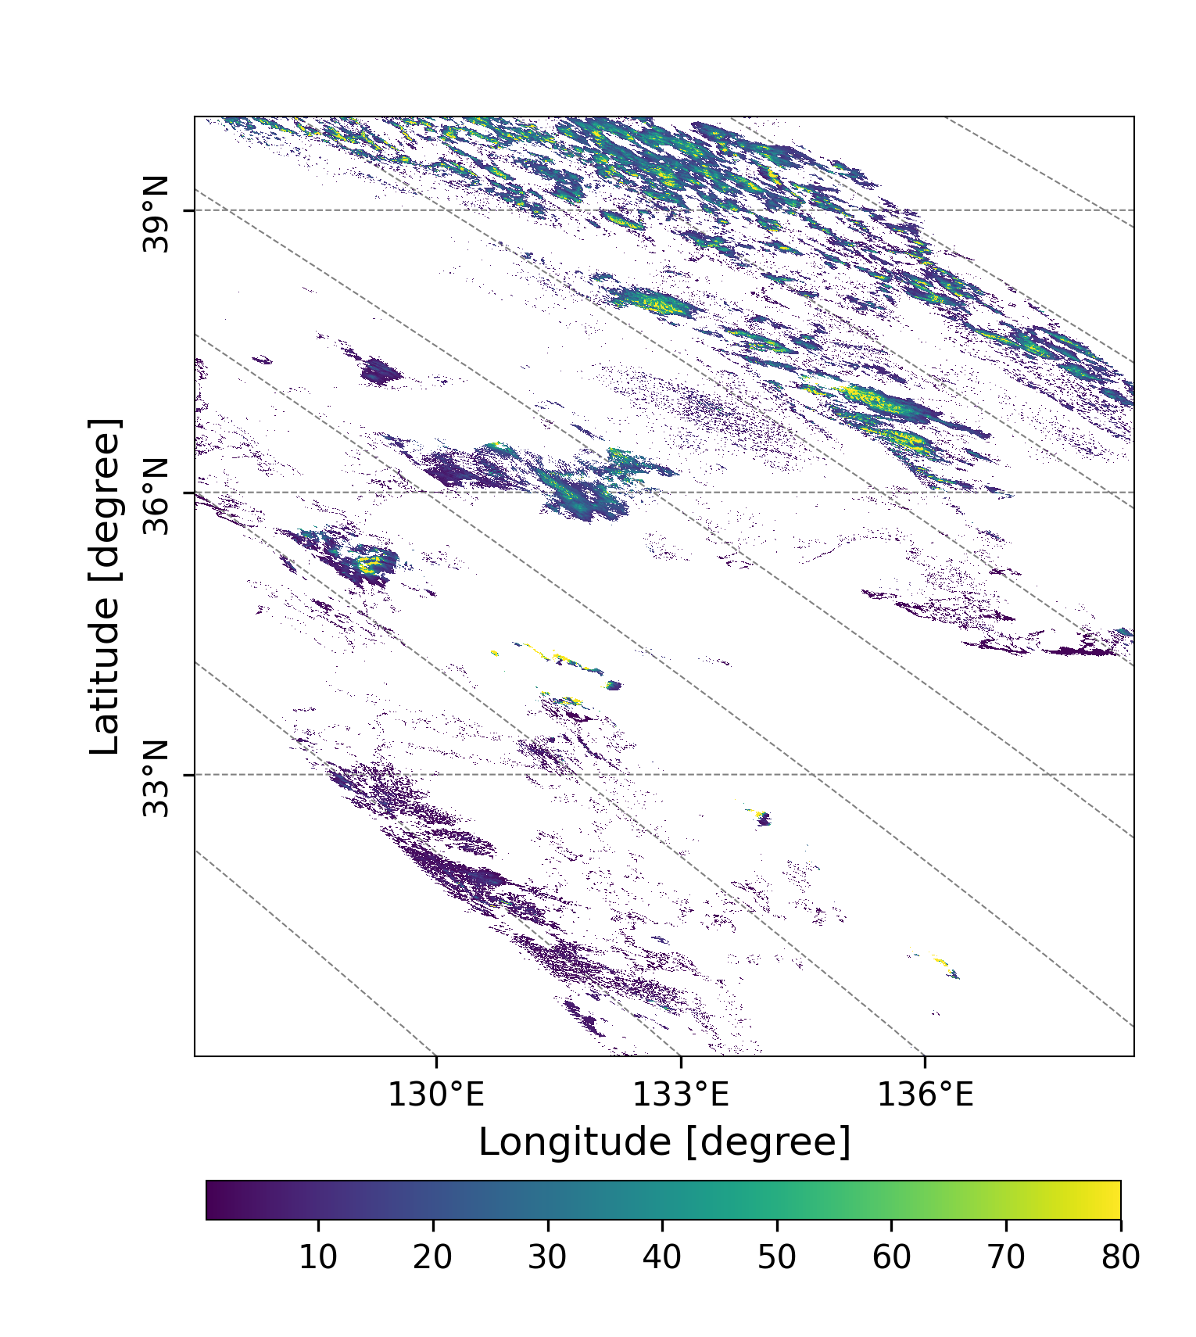
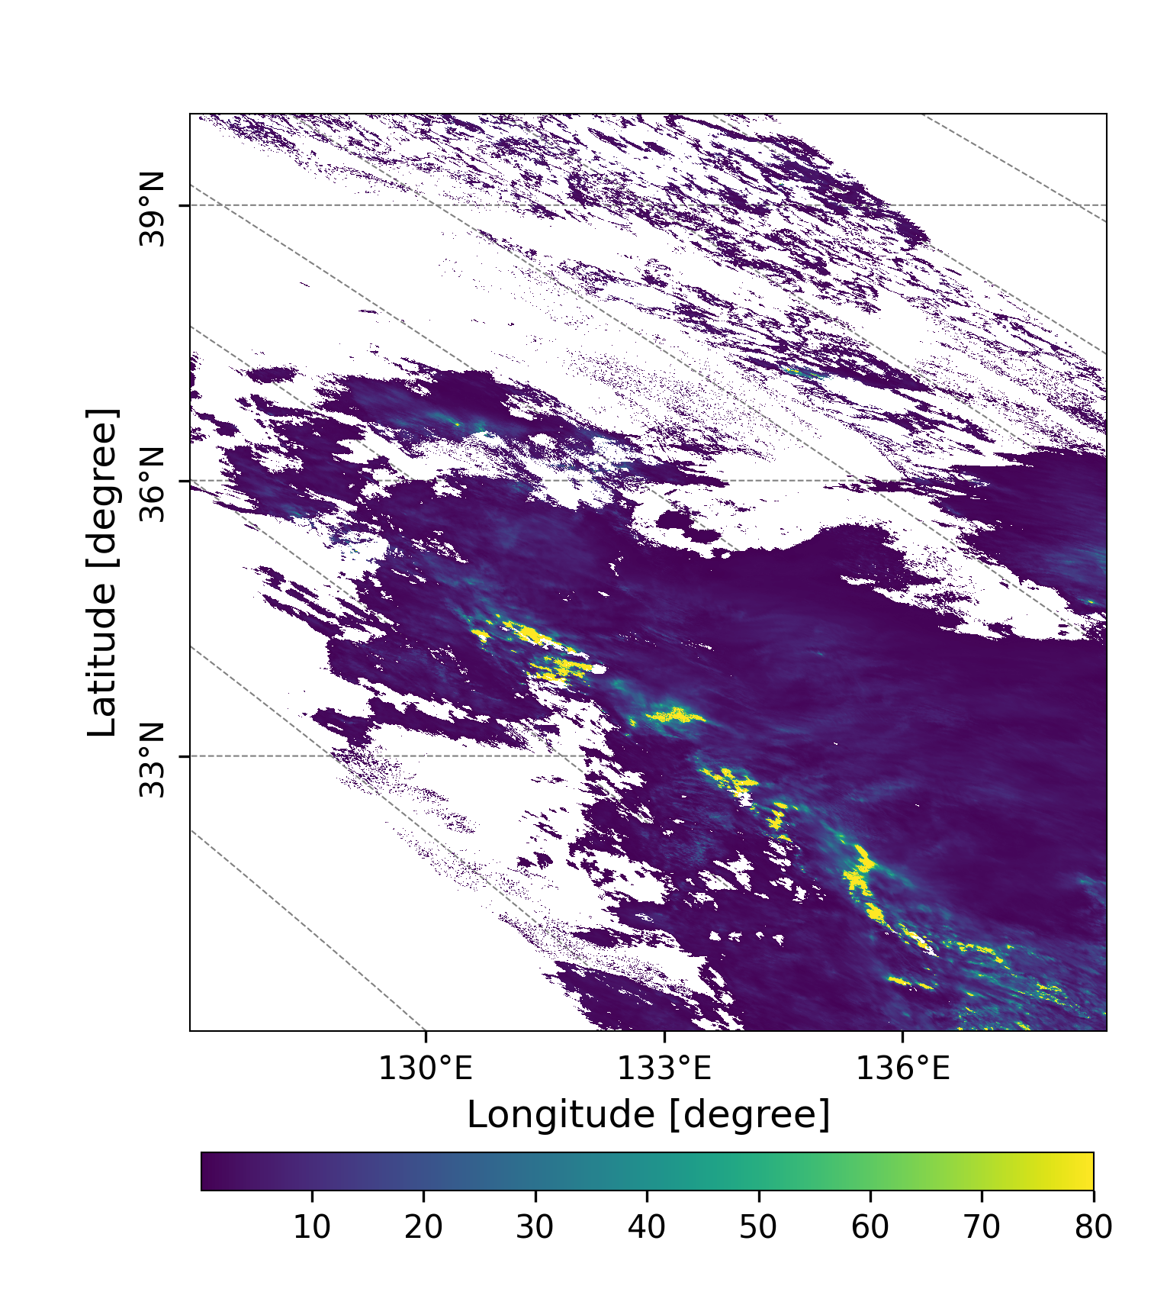
GC1SG1_20221128D01D_T0529_L2SG_CLPRK_3000.h5
(a)
(b)
high and thin
cloud (cirrus)
exists.
Figure 5. Liquid water cloud optical thickness(a), and ice cloud optical thickness (b) over Honshu and Shikoku (本州＋四国)observed by GCOM-C on Nov.28, Monday.

Slide 7
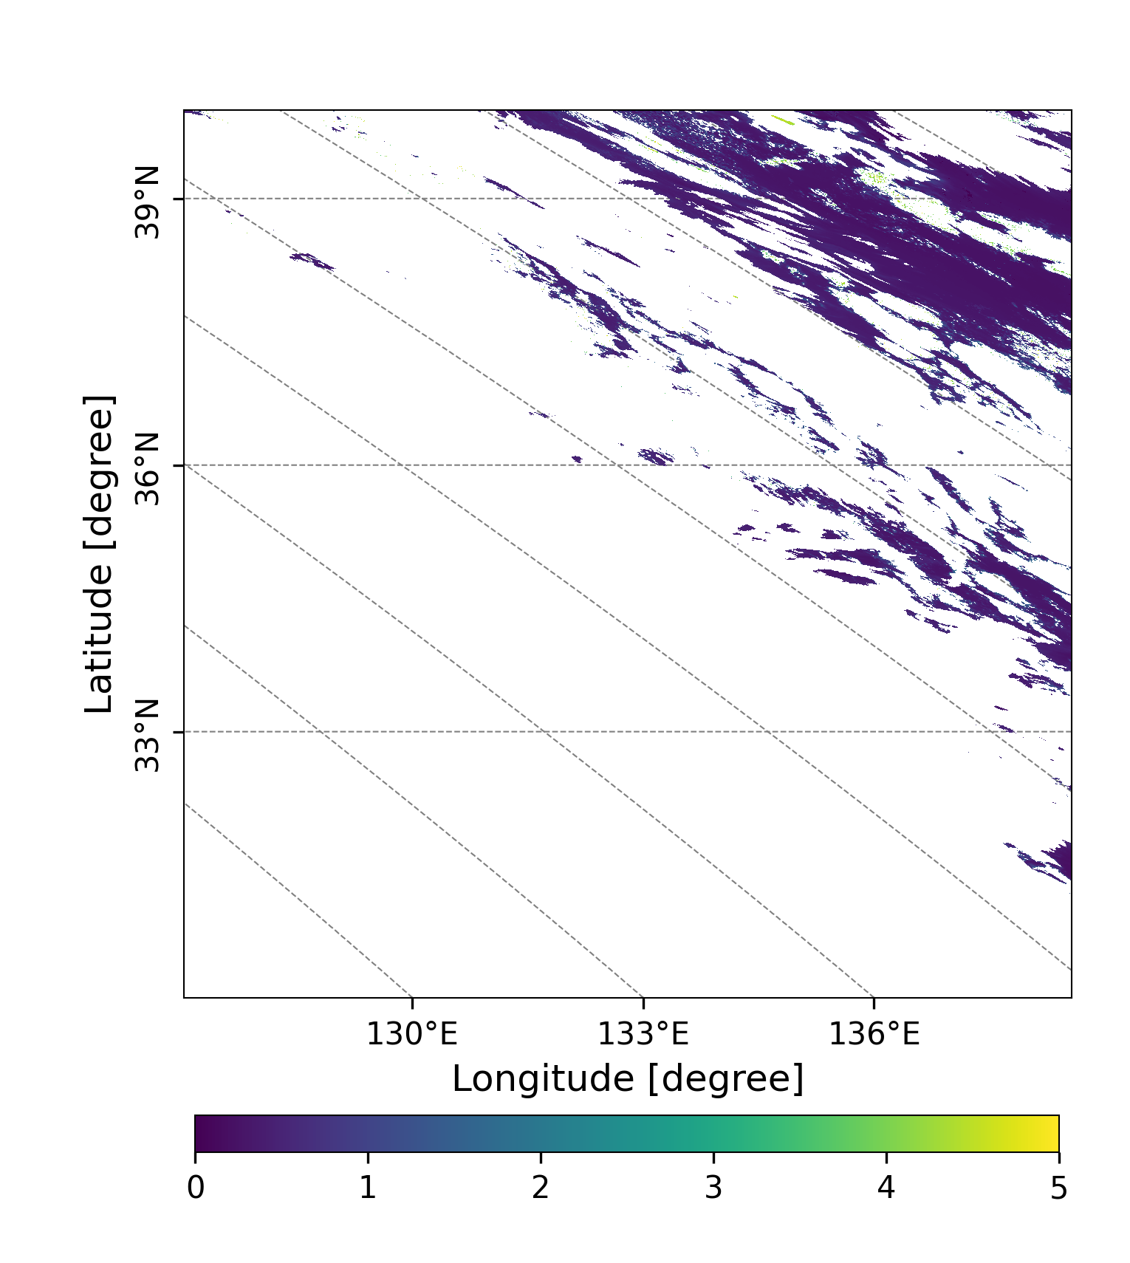
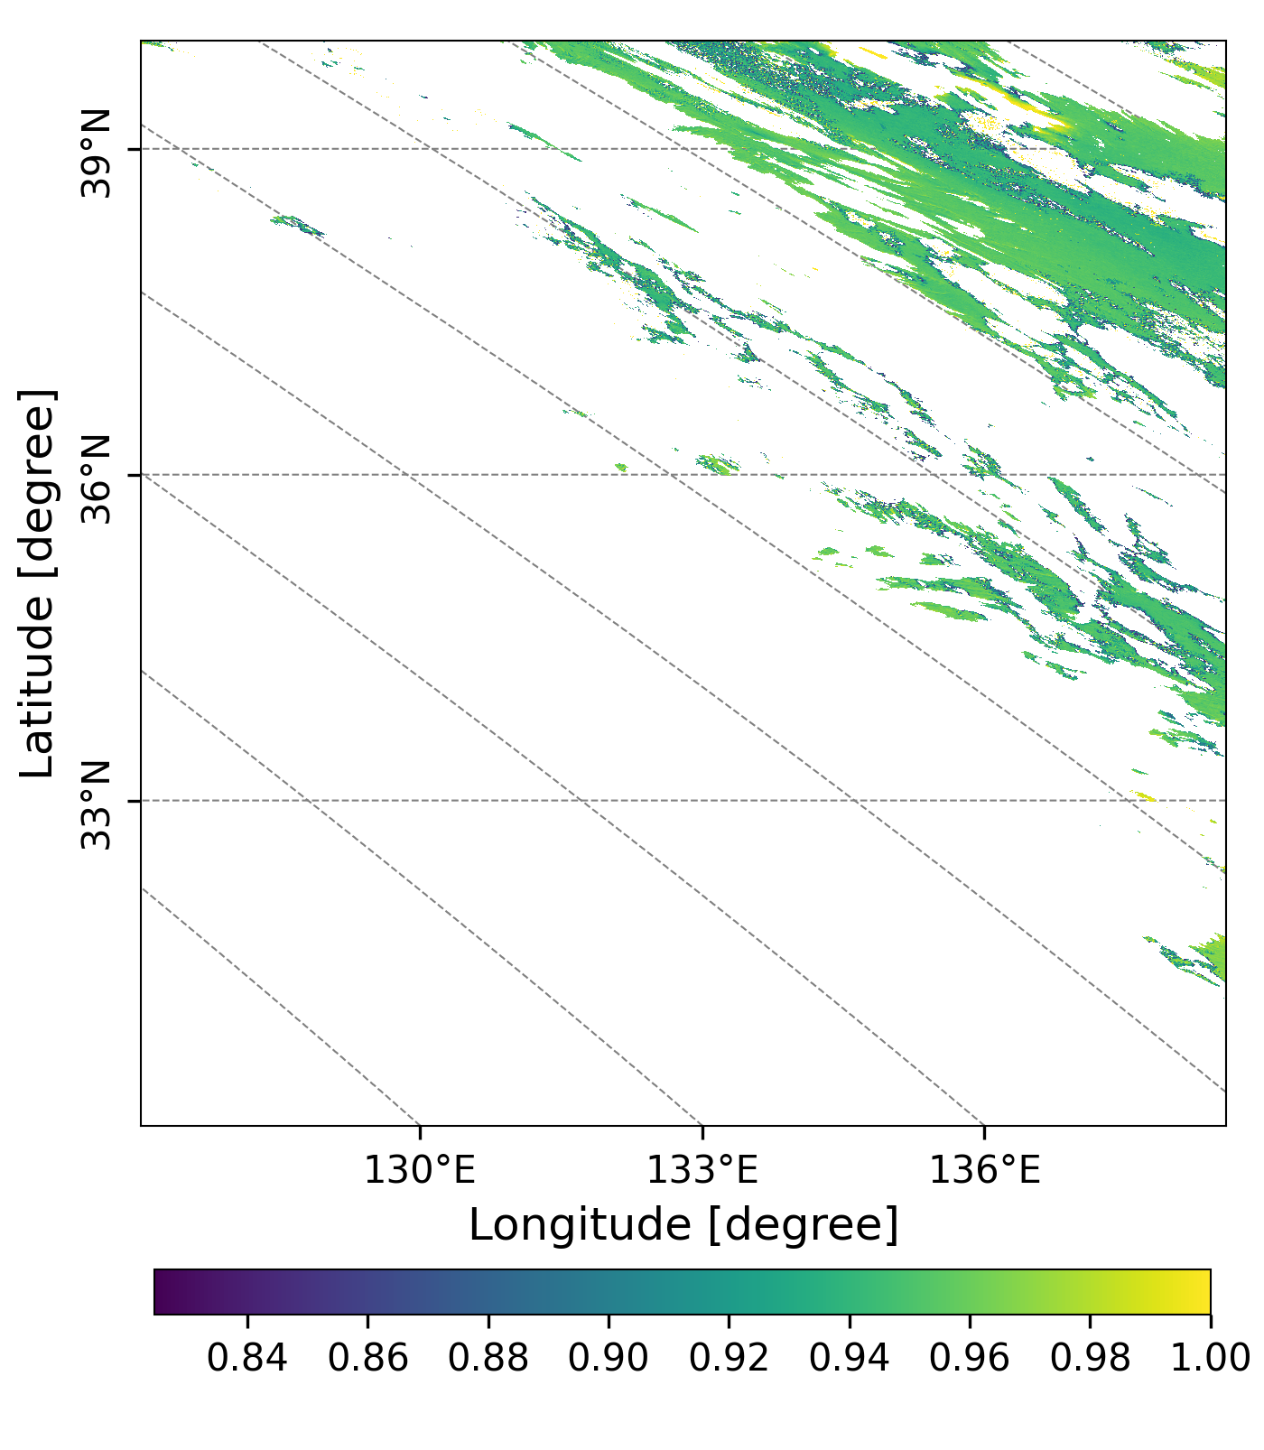
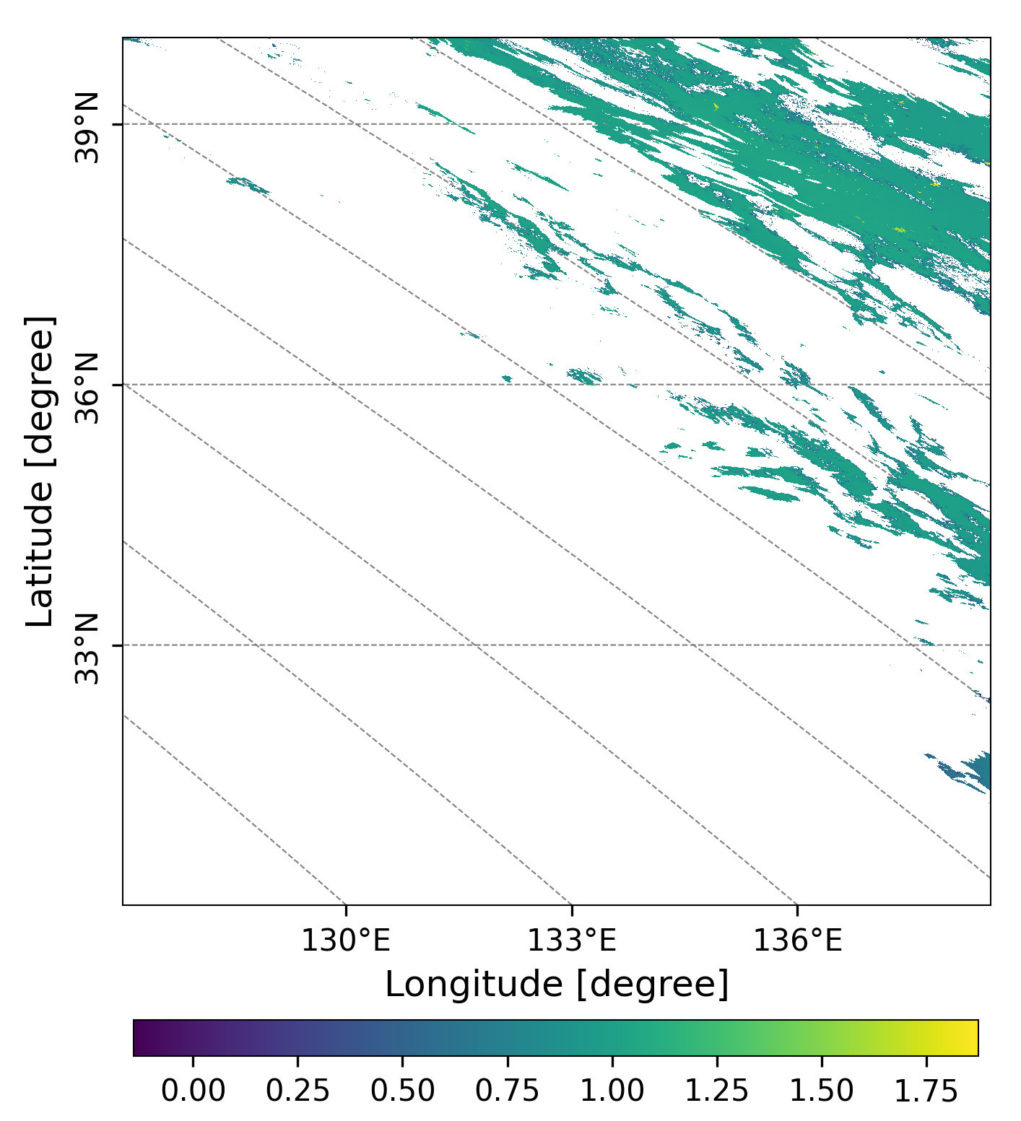
20221130
GC1SG1_20221129D01D_T0529_L2SG_ARNPK_3004.h5
(a)
(b)
(c)
Figure6. AOD (a) at 500 nm, SSA(b) at 380 nm and AE(c) at 500 and 380 nm over Honshu and Shikoku (本州＋四国)observed by GCOM-C on Nov.29, Tuesday.

Slide 8
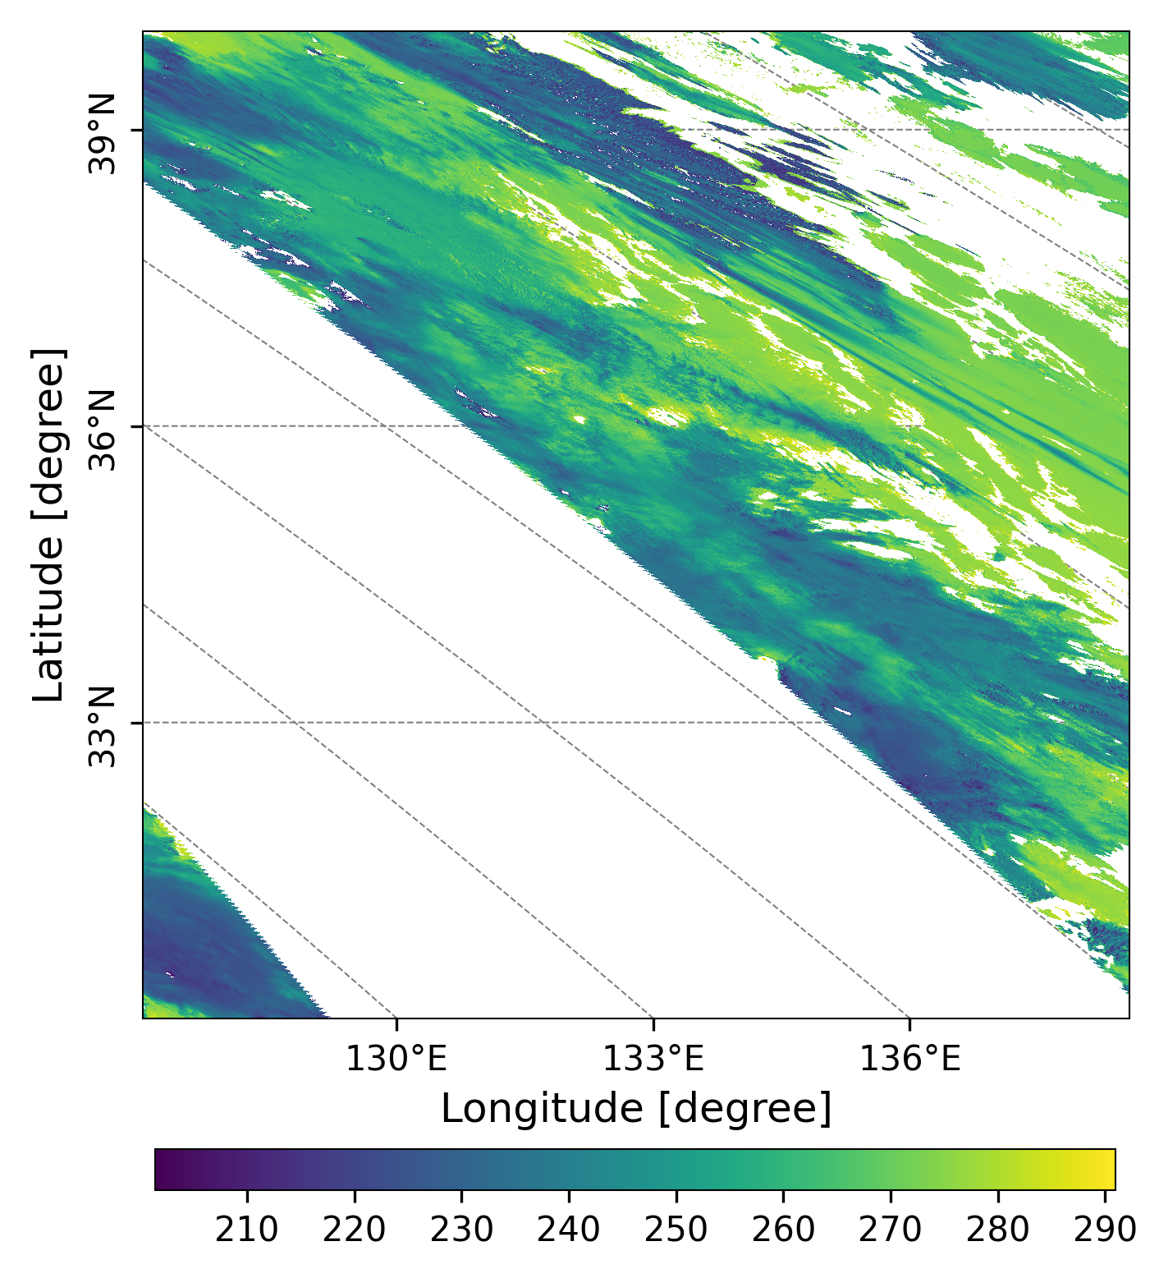
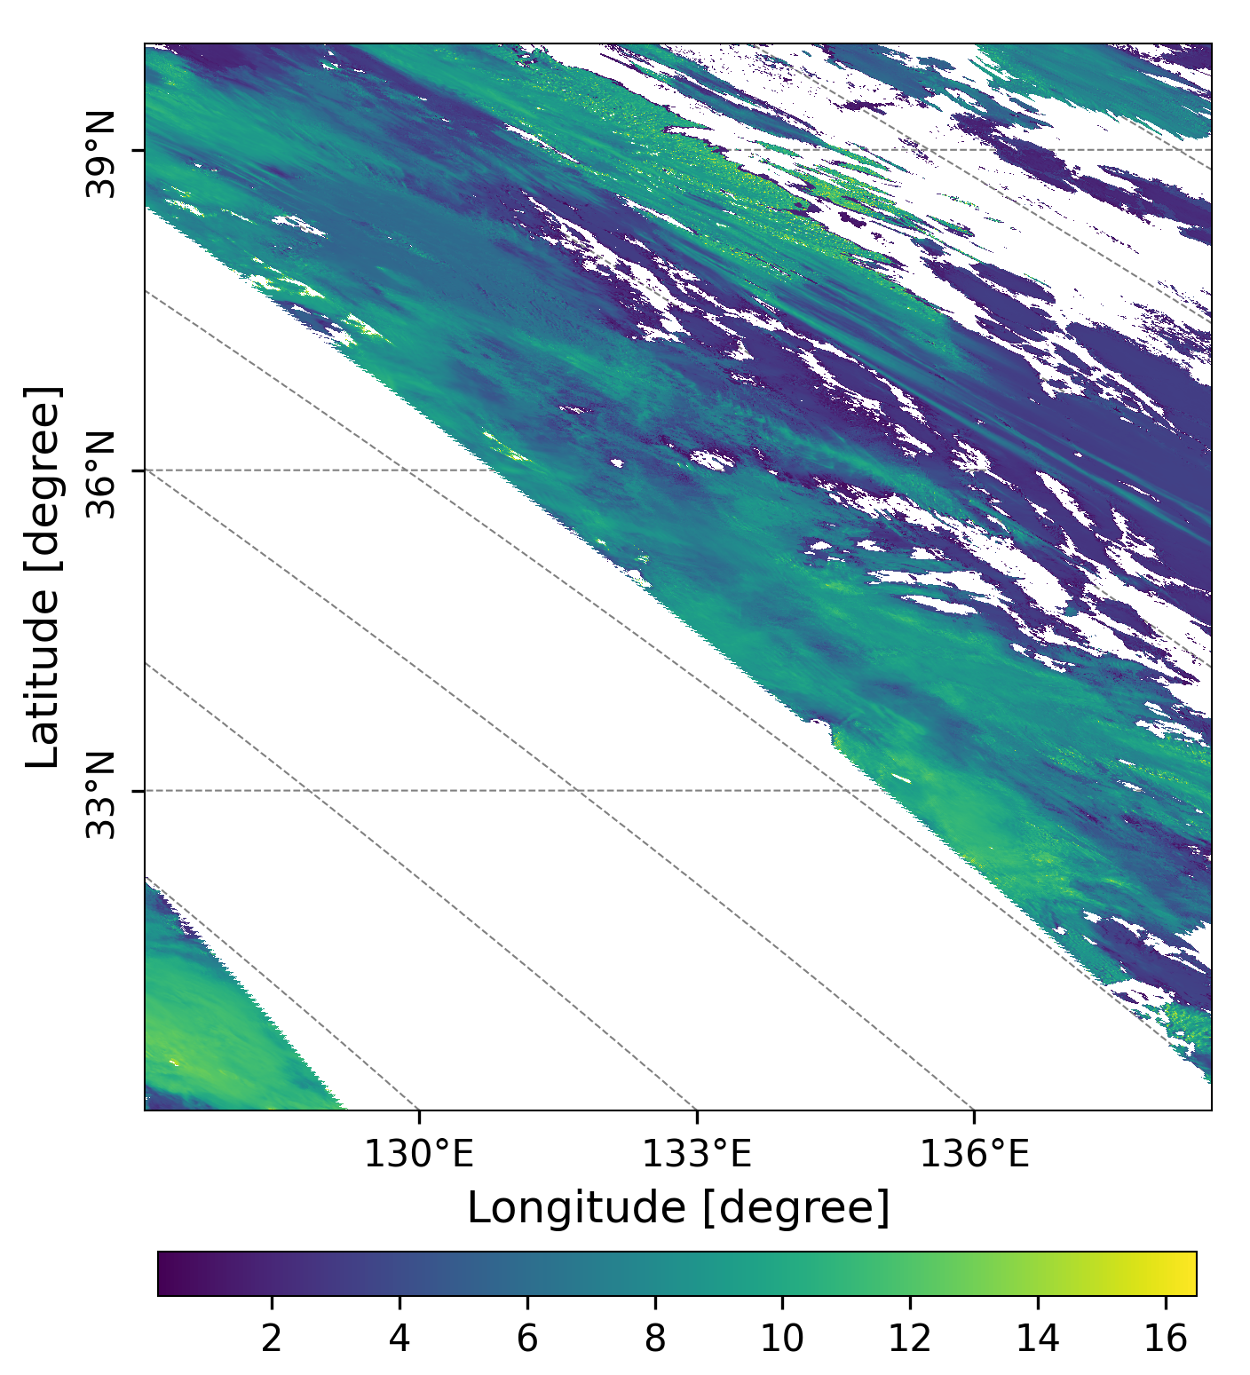
GC1SG1_20221129D01D_T0529_L2SG_CLPRK_3000.h5
Figure 7. Cloud Top Temperature (a, Unit: K), and Cloud Top Height (b, Unit: Km) over Honshu and Shikoku (本州＋四国)observed by GCOM-C on Nov.29, Tuesday.

Slide 9
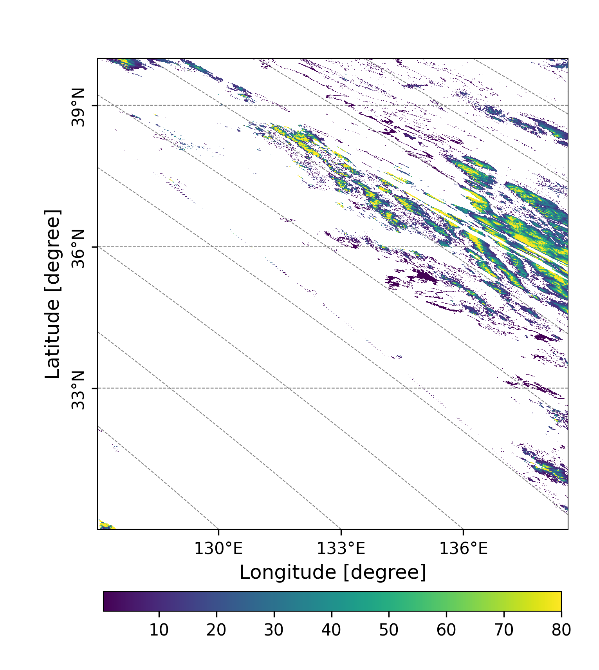
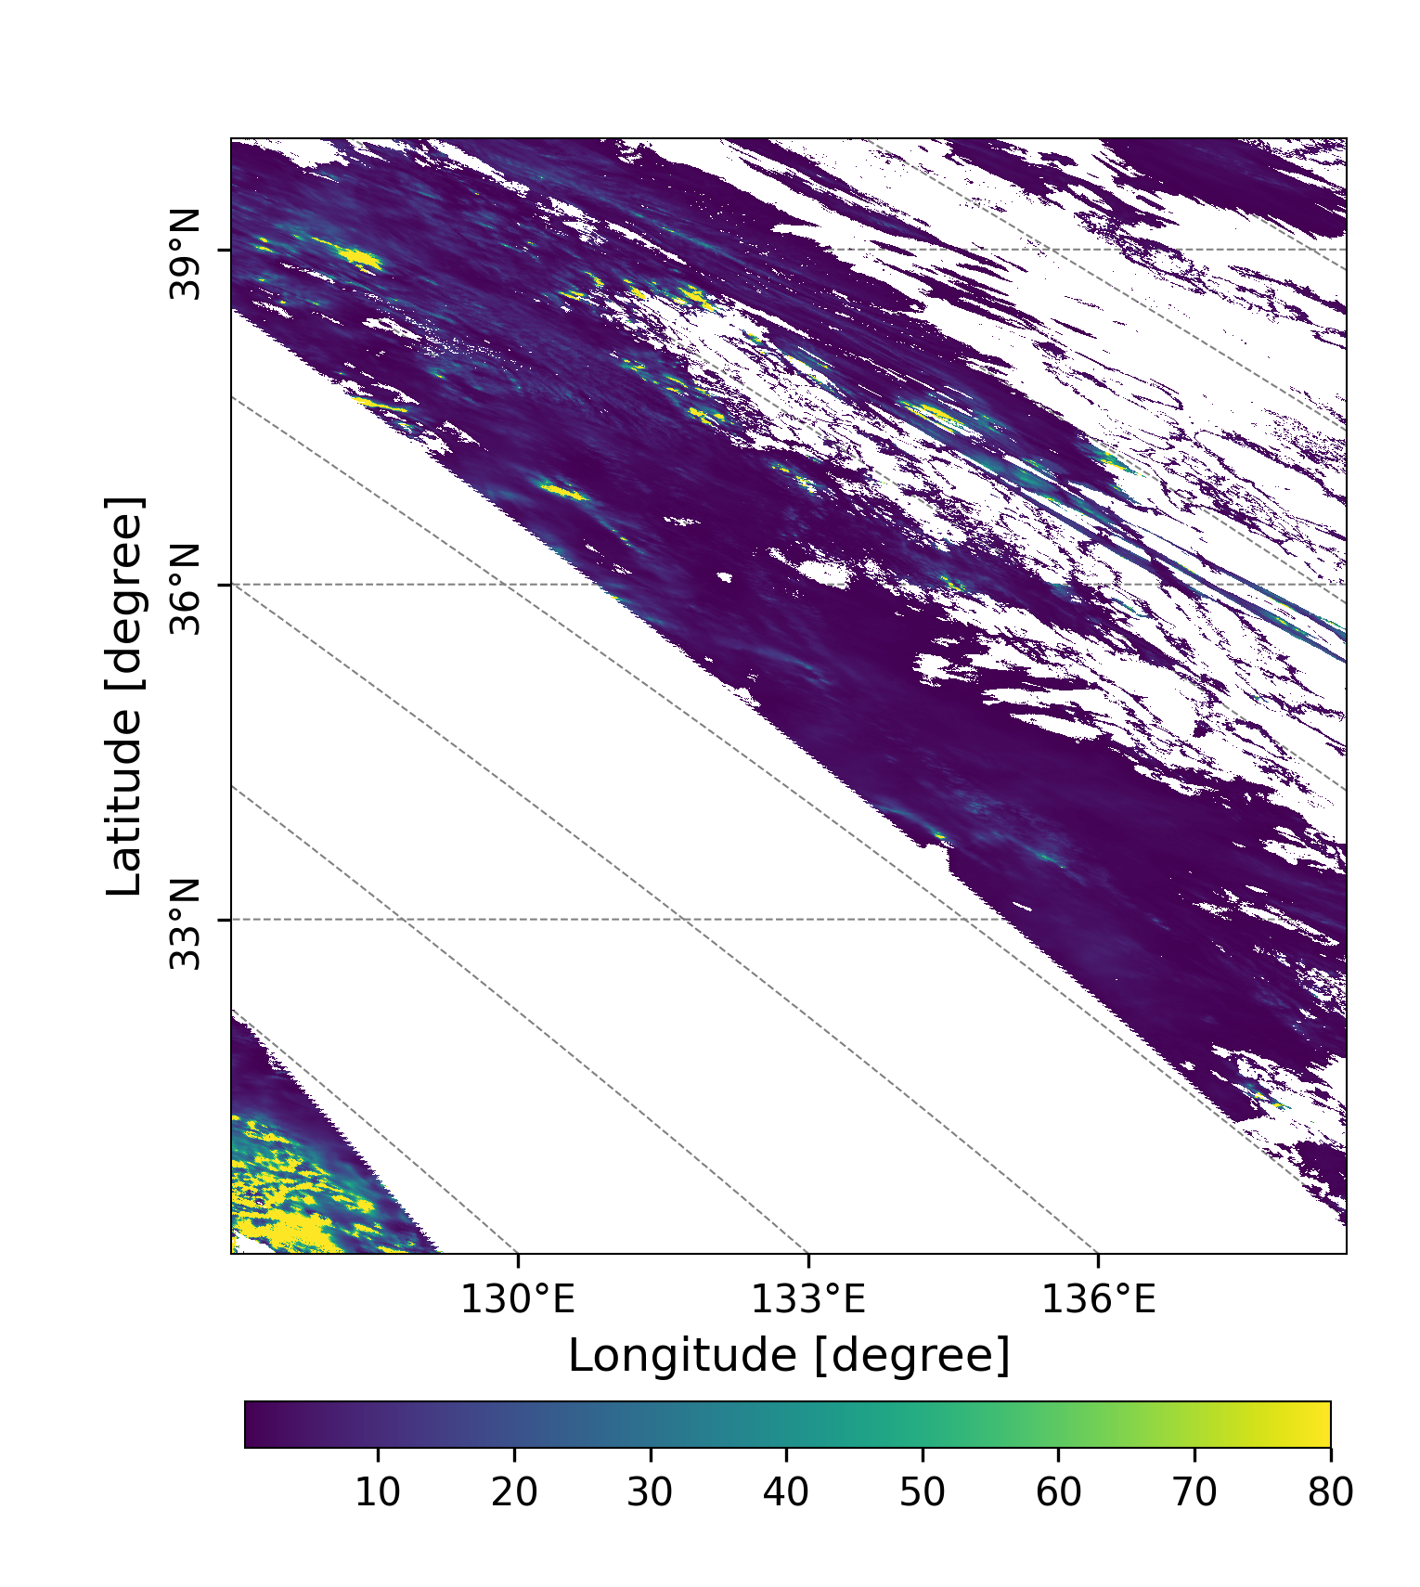
GC1SG1_20221129D01D_T0529_L2SG_CLPRK_3000.h5
(a)
(b)
airplane trail cloud?
Figure 8. Liquid water cloud optical thickness(a), and ice cloud optical thickness (b) over Honshu and Shikoku (本州＋四国)observed by GCOM-C on Nov.29, Tuesday.

Slide 10
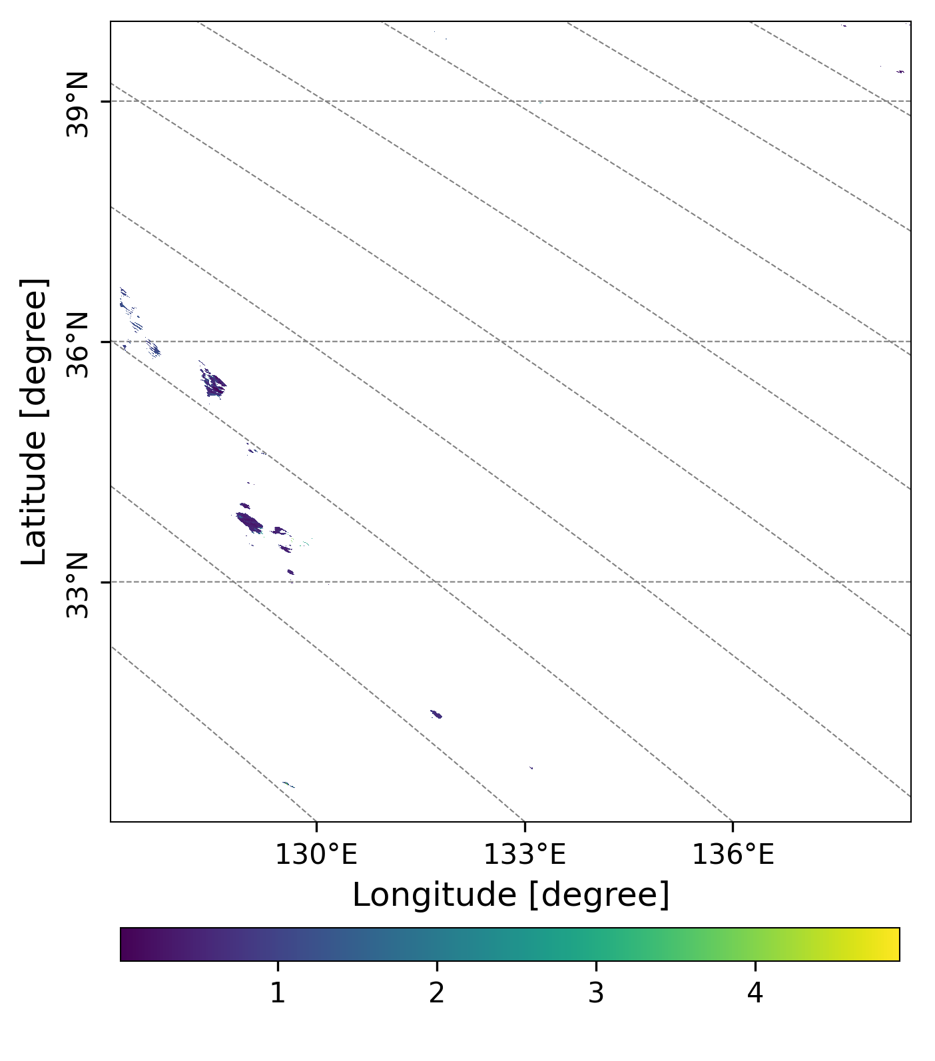
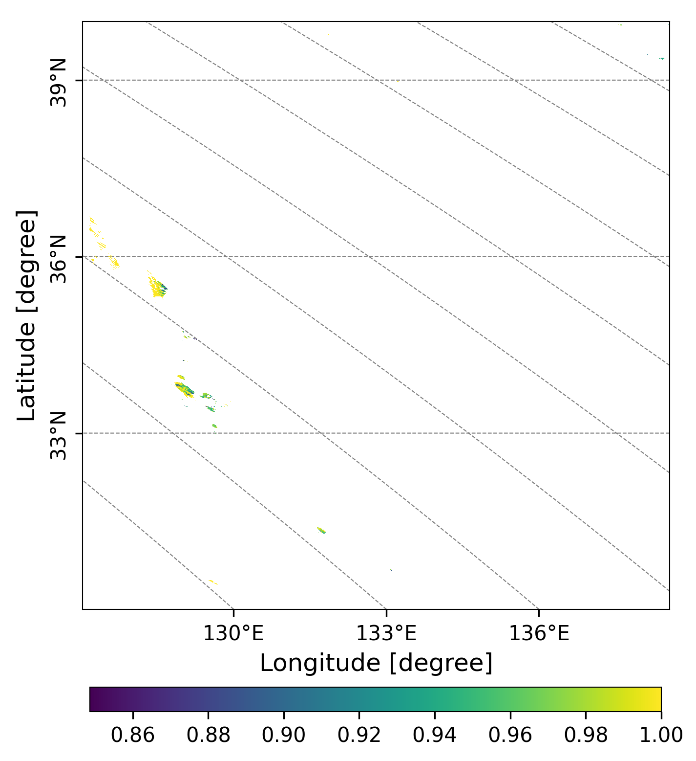
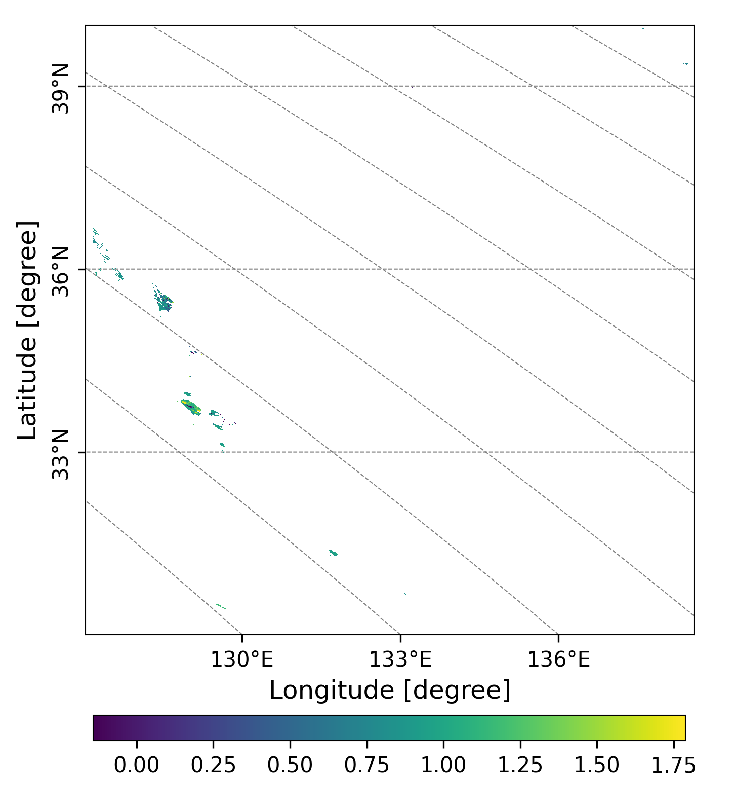
20221201
(a)
(b)
(c)
Cloudy. Only
sevaral pixels have
aerosol products.
Figure 9. AOD (a) at 500 nm, SSA(b) at 380 nm and AE(c) at 500 and 380 nm over
Honshu and Shikoku (本州＋四国) observed by GCOM-C on Nov.30, Wednesday.

Slide 11
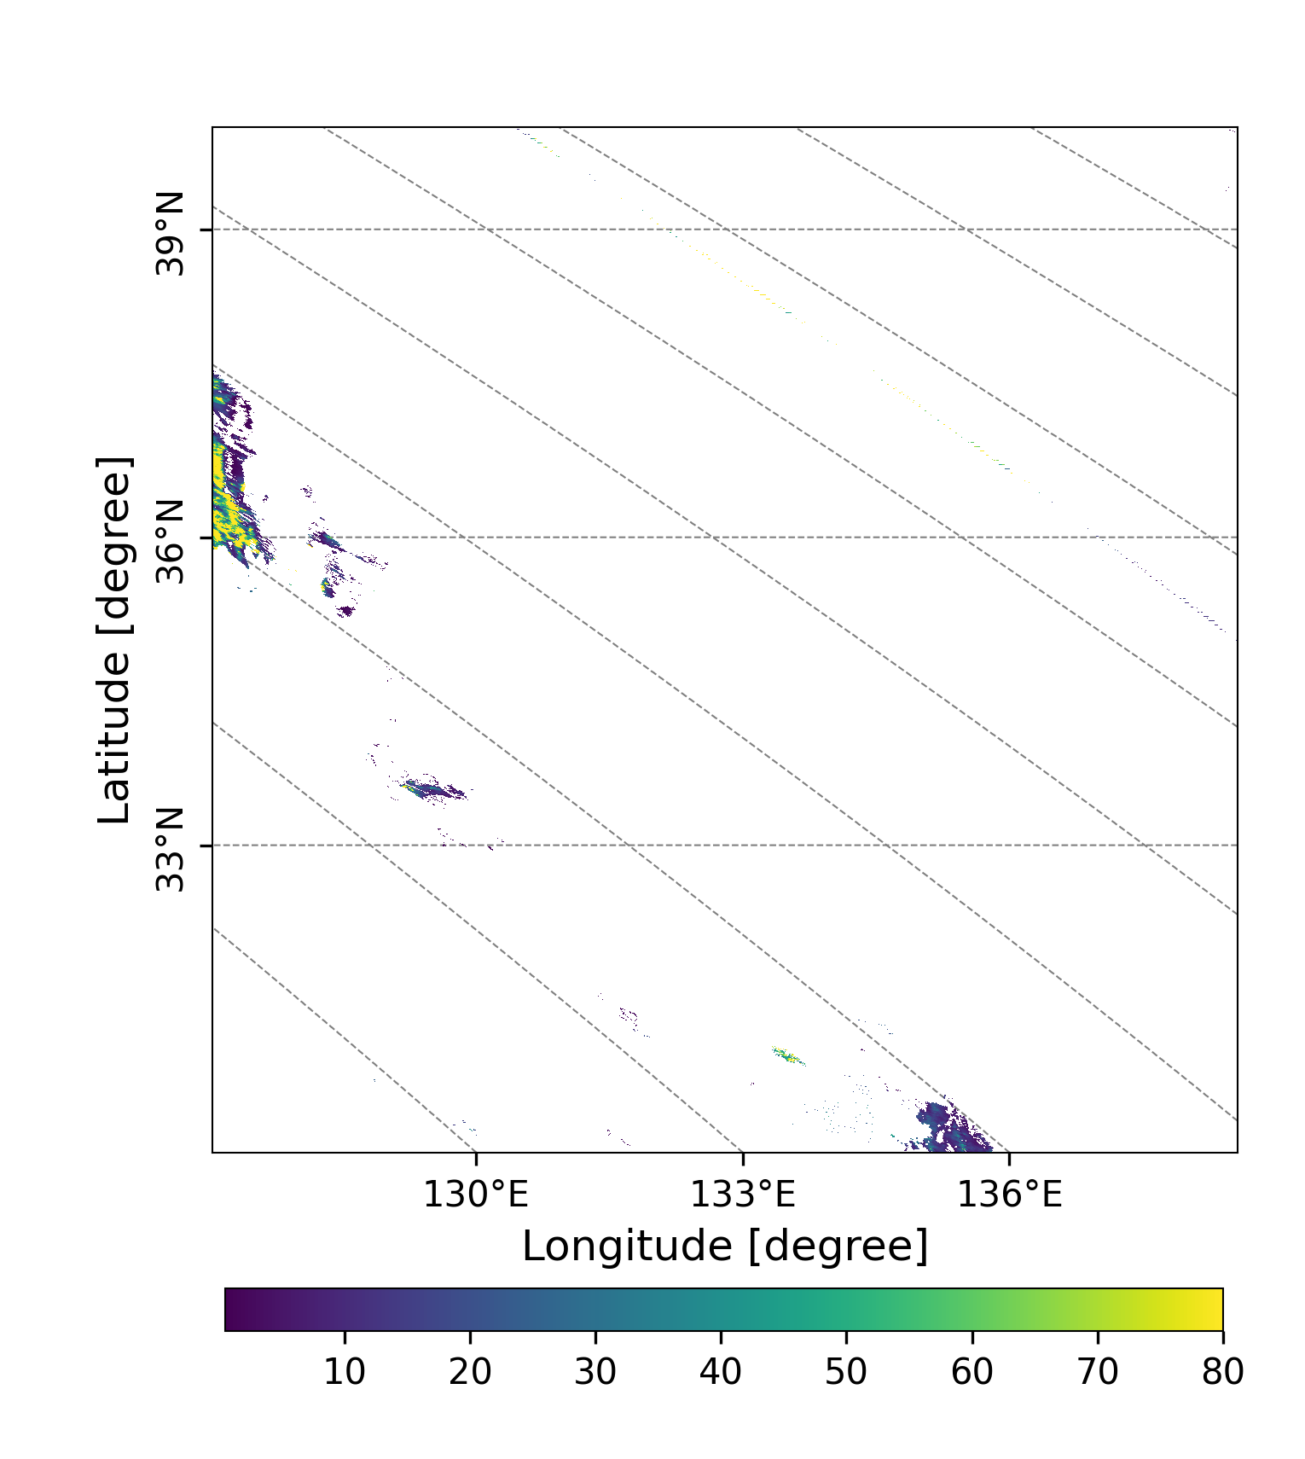
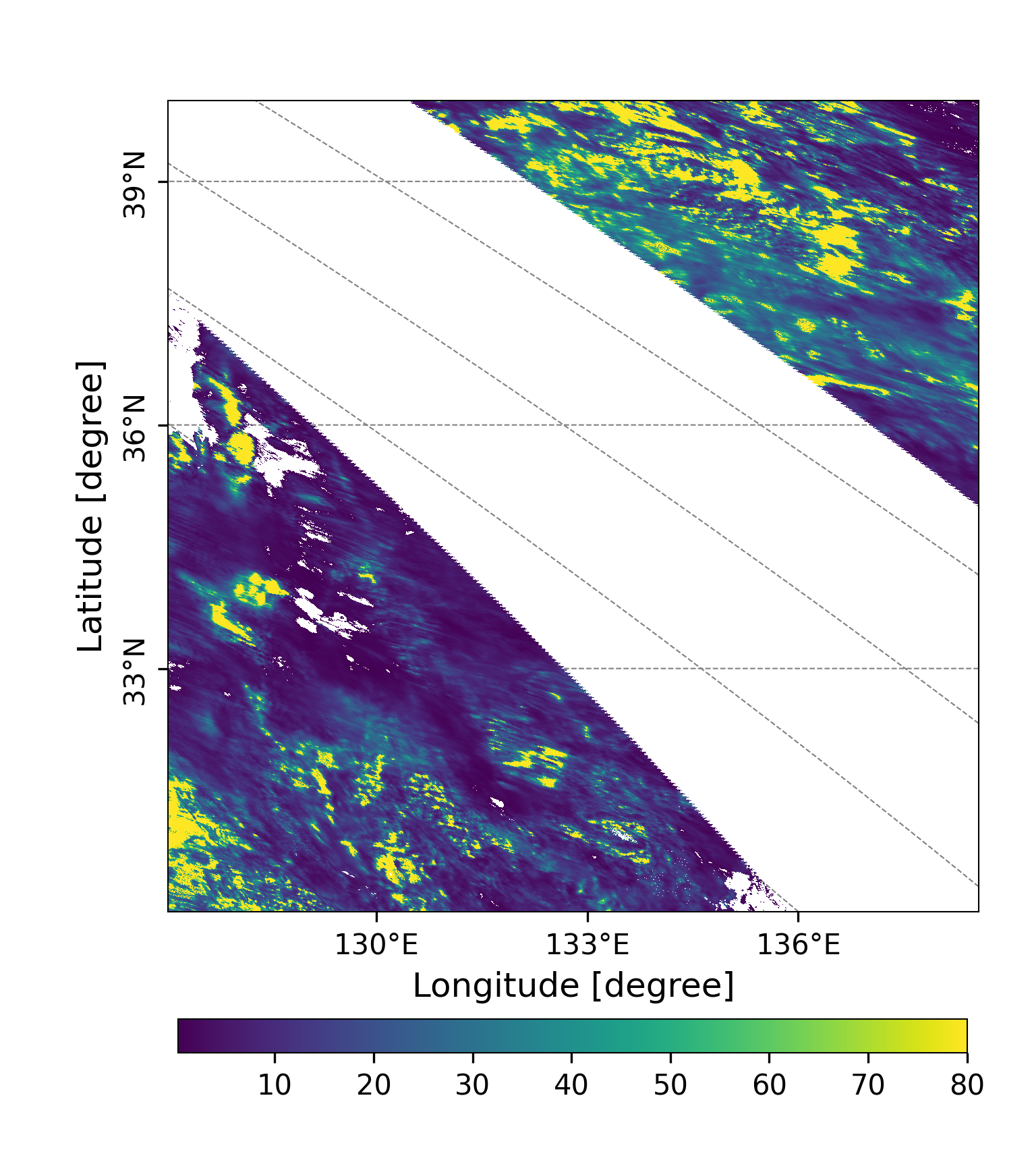
(a)
(b)
A large area was
taken up by ice clouds.
Optically thick clouds
may indicate the oocurence
of convective weather,
such as snow and
preciptation.
Figure 10. Liquid water cloud optical thickness(a), and ice cloud optical thickness (b)
over Honshu and Shikoku (本州＋四国)observed by GCOM-C on Nov.30, Wednesday.

Slide 12
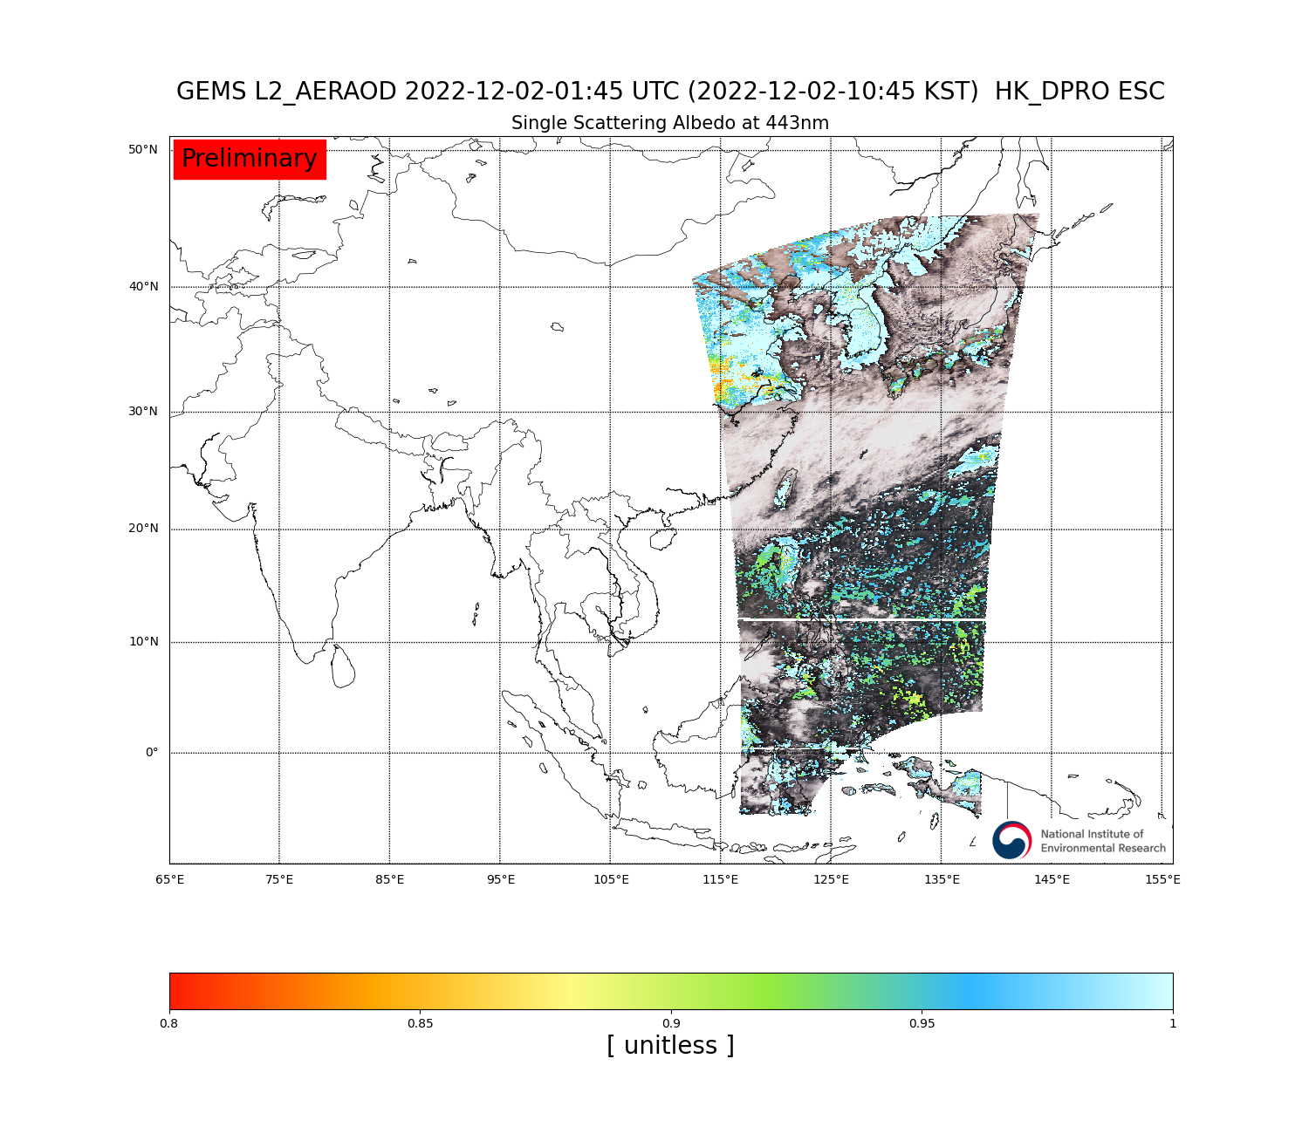
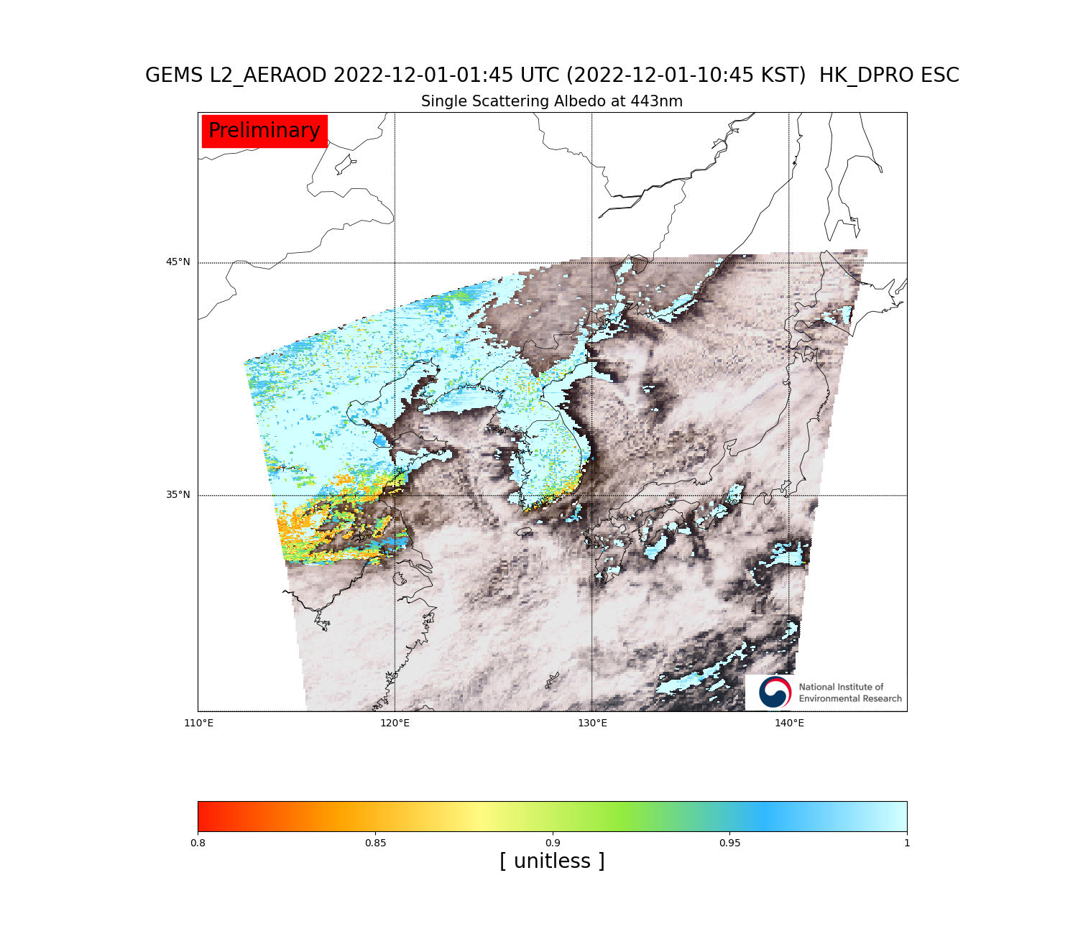
Figure 1. AOD at 443 nm observed by GEMS on 10:45 KST, Dec. 2, 2022

Slide 13
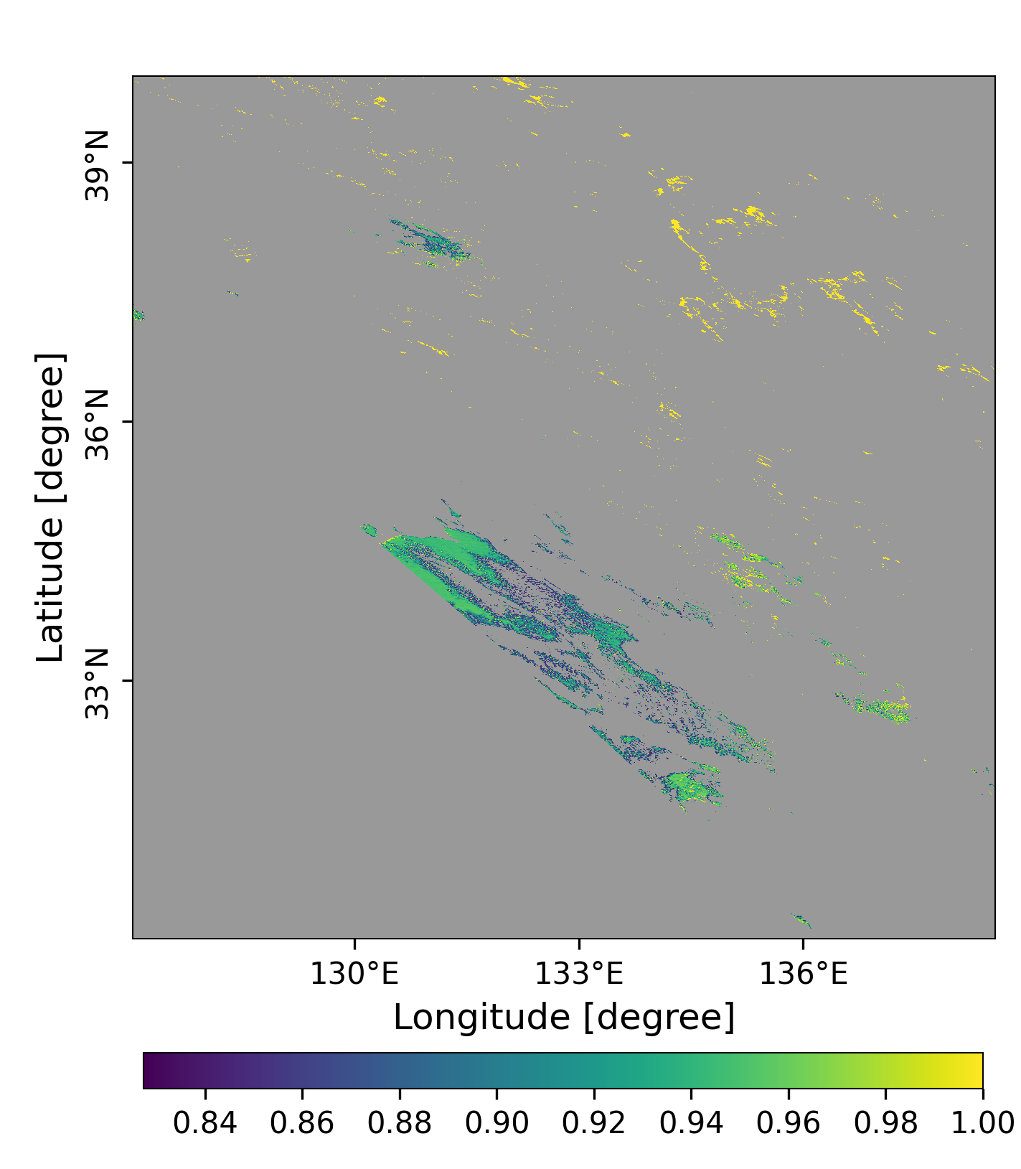
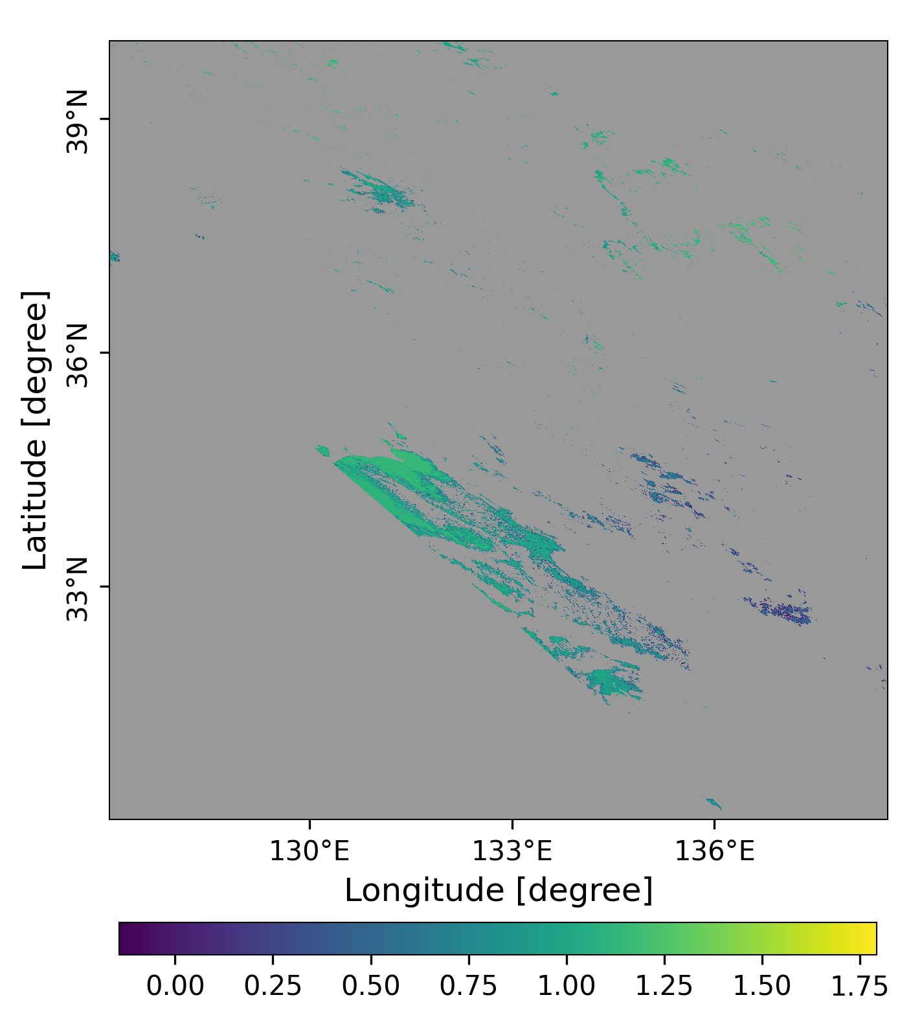
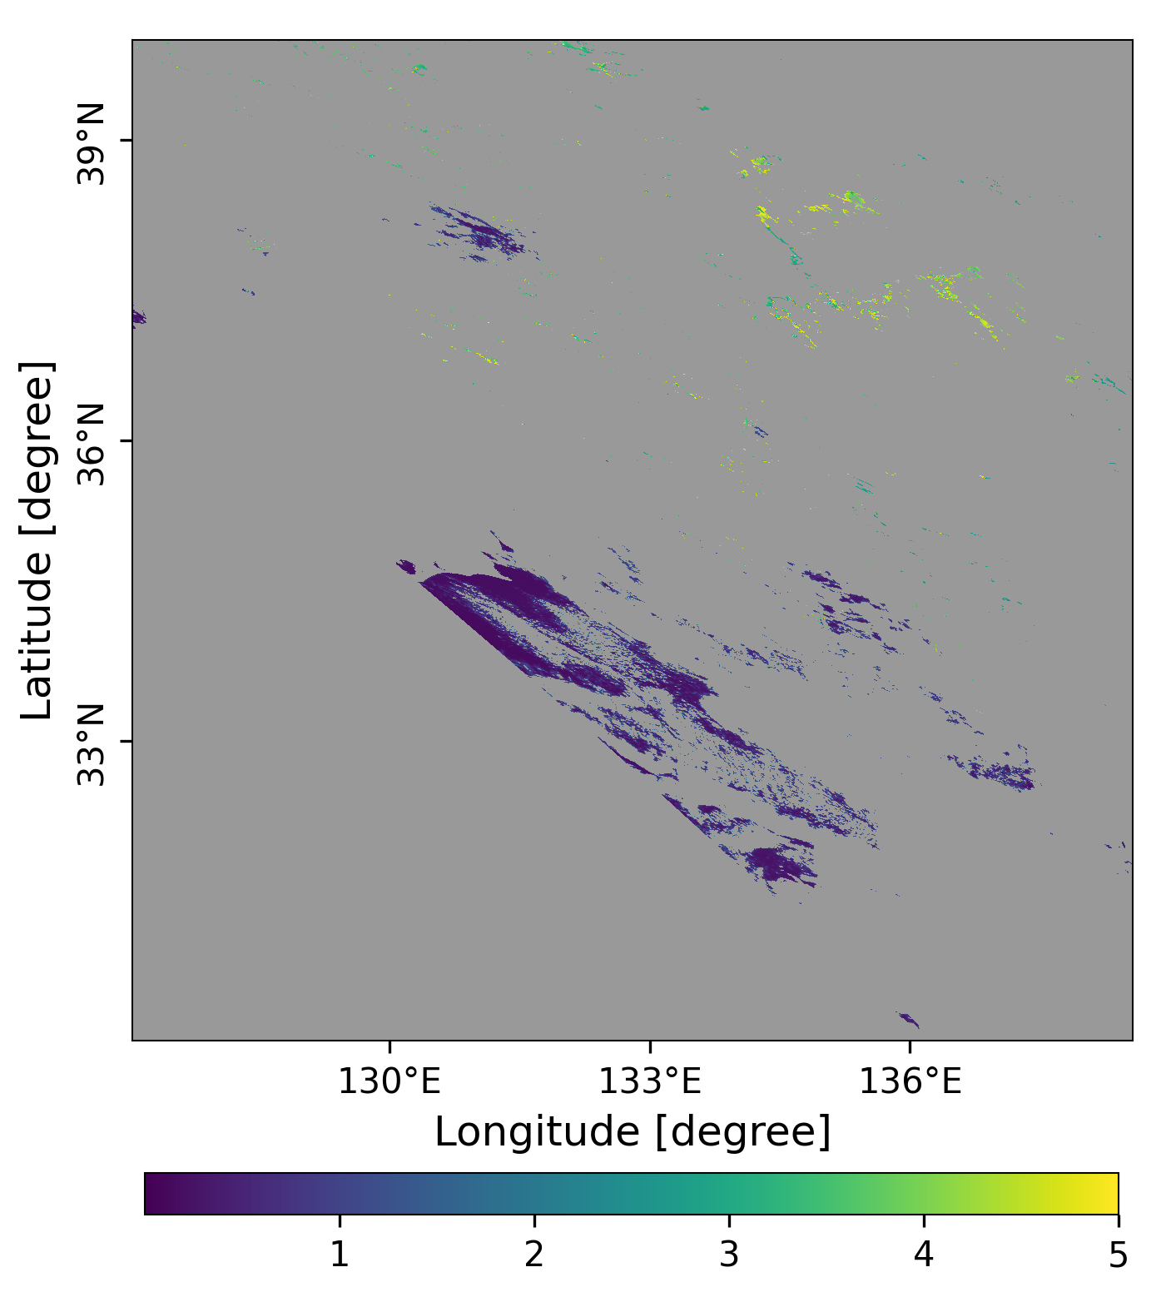
20221207
(a)
(b)
(c)
Figure 1.AOD (a) at 500 nm, SSA(b) at 380 nm and AE(c) at 500 and 380 nm over Honshu and Shikoku (本州＋四国)
observed by GCOM-C on Dec.06, Tuesday.

